Slide 1
Guess the movie

Slide 2
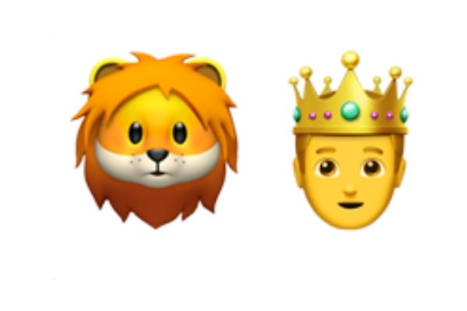

Slide 3
The Lion King

Slide 5
Frozen

Slide 7
Moana

Slide 8
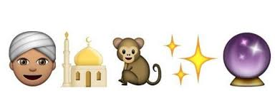

Slide 9
Aladdin

Slide 11
Inside Out

Slide 12
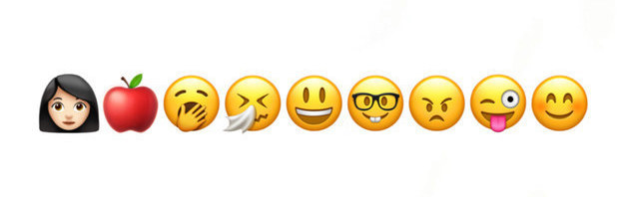

Slide 13
Snow White and the 7 Dwarves

