Slide 1
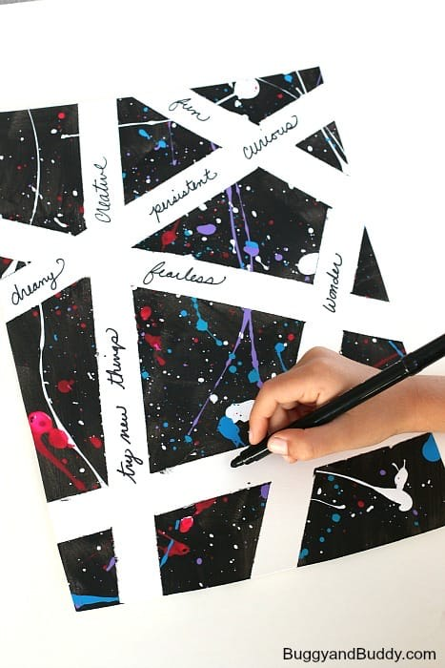
Positive Personal Traits
Art and PDMU

Slide 2
Positive Personal Trait
Examples
Persistent
Courageous
Brave
Creative
Curious
Risk - taker
Imaginative
Fearless
Empathetic
Original
Self – confident
Forgiving

Slide 3
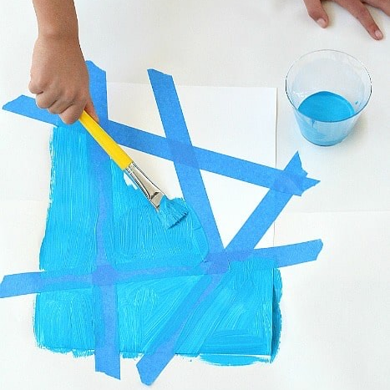
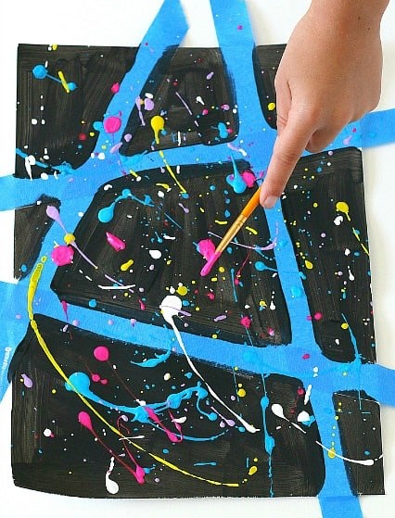
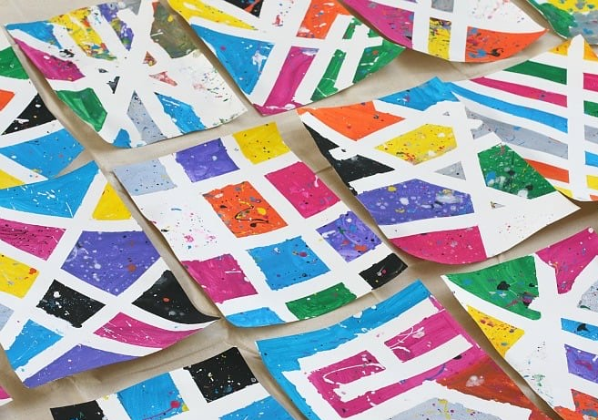
Background
1. Place intersecting strips of masking tape across a piece of white card
2. Paint over the entire page.
use one colour if they want to do multi-coloured paint splatters
paint a multi-coloured background and then use white/black paint splatters)
3. Splatter paint over the entire page;
flicking it off a paintbrush
placing drops onto the page and using a straw to blow the paint in different directions
using the end of a paintbrush to create random dots.
4. Carefully peel off the masking tape to reveal the completed background

Slide 4
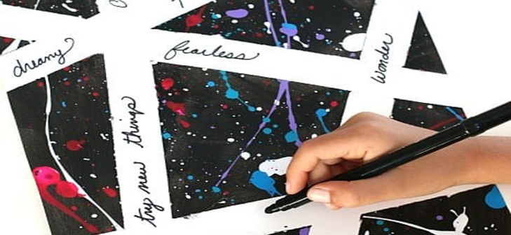
Positive Traits
Fill in the blank spaces with phrases/words from your worksheet
If there is a positive trait that you have seen in the examples or seen on somebody elses page and it is a positive trait you think you could show more of/ work on, add it to your page as a reminder of what you can achieve!

