Slide 1
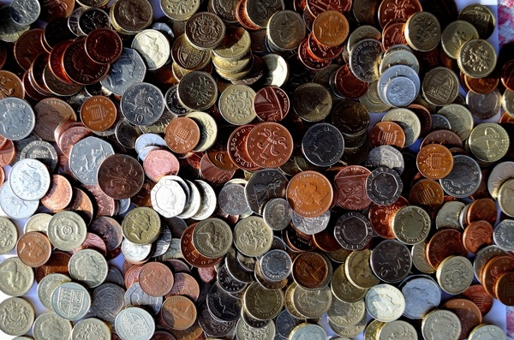

Money
A guide for Parents

Slide 2
This guide includes:
The Northern Ireland Curriculum - what your child will learn at school
The importance of teaching children about money
Ideas for learning about money through play and practical experiences.

Slide 3

Foundation stage:
Primary 1 and Primary 2 children
In school children will learn to:
use money in various contexts
talk about things that they want to spend money on
understand the need to pay for goods
become familiar with coins in everyday use
use their number skills in shopping activities

Slide 4
Key Stage 1:
Primary 3 and Primary 4 children
In school children will learn to:
• recognise coins and use them in simple contexts
add and subtract money up to £10, use the conventional way of recording money and use these skills to solve problems
talk about the value of money and ways in which it could be spent, saved and kept safe
talk about what money is and alternatives for paying, for example, cash, cheque book, debit card, credit card
decide how to spend money

Slide 5

The importance of teaching children about money
Teaching your child about the value of money can be fun and educational at the same time. By playing educational games with your child and letting them participate in real life situations, you are teaching them the value of money and the important role it plays in our everyday world.
Reinforce this learning by allowing your child to pay for a treat at the shop using the money from their piggy bank or having them make a deposit at the bank.

Slide 6
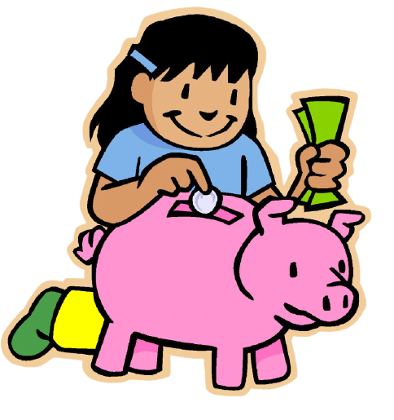
Allow your child to keep their money in a piggy bank.
The first step to teaching your child about money is to familiarise them with the different coins and their values.

Slide 7
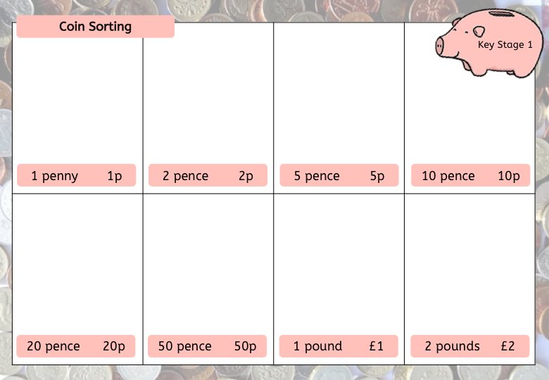
Sorting -
Ask your child to sort the coins into separate piles using the template provided.
After your child has sorted the coins, count them.
(You may find ‘counting coins’ a useful resource for this)
Sort 1p, 2p, 5p and 10p coins
Sort all coins
Foundation
Stage
Key Questions:
What colour are each of the coins?
Which coin is the biggest?
Which coin is the smallest?
How much is this coin worth?
What coin is worth the most?
How many 1p’s are in 10p?
Key Stage 1

Slide 8
Cut around the coin flashcards.
Pairs:
Put the cards face down on the table and allow your child to turn over 2 cards. If the cards are not a match, turn them back over and let your child try again.
Snap:
Split the cards into two piles and play snap.
If your child makes a match or a snap, ask your child to state the name and the value of the coin.
Key Questions:
What is the coin called?
What value does this coin have?
How many 1p’s are in 10p?
Can you think of another way to make this value?

Slide 9
Different ways to make -
This allows children to explore how one coin relates to another.
For example 10 pennies are the same as one 10 pence.
Children can check they are correct by using dots above/on the coin to represent its value and then counting all of the dots.
Use values up to 10p
Use values up to £1
Foundation
Stage
Key Stage 1

Slide 10
Shopkeeper -
Set up a pretend shop using items in your home. Use the various price tags provided.
Give your child a selection of coins to purchase the item of their choice.
Have your child give you the correct coins to pay for the item.
If your child is the shopkeeper make occasional mistakes and allow them to check if you have given the correct amount.
Extra challenge:
Buy more than one item
Increase the price tags
Most and fewest: Figure out how to make the amount with the most number of coins and the fewest number of coins
Allow your child to give change (using the counting on approach)

Slide 11
Bank teller -
Set up a pretend bank in your home with a toy computer/laptop and a selection of coins.
Make out pretend cheques. Let your child be the bank teller and tell them you are there to cash your cheque. Allow them pick out the correct coins to give.
Key Stage 1
Extra challenge:
Increase the amounts of the cheques
Cash multiple cheques at a time

Slide 12
Bank teller -
Set up a pretend bank in your home with a toy computer/laptop and a selection of coins.
Allow your child to look at your cards. This will allow them to become familiar with the different features (chip and pin, expiry date, card number, magnetic strip, signature) .
Allow them to create their own card and use this in their pretend bank, to ‘withdraw’ money.
Key Stage 1

Slide 13
Have fun!

