Slide 1
Hello! How are you? Click on the emoji that you are feeling most like.

Slide 2
Let’s learn

Slide 3
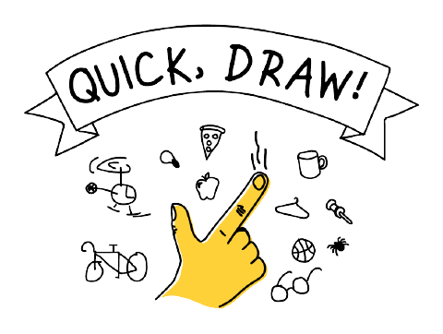
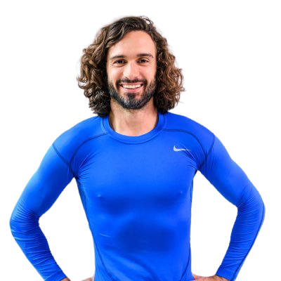
Have a dance - It's Time to Slime!
Quick draw with Google
Now you are ready to learn!
5 Minute Move with Joe Wicks

Slide 4
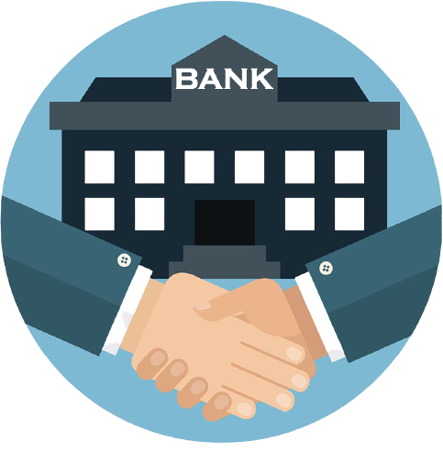
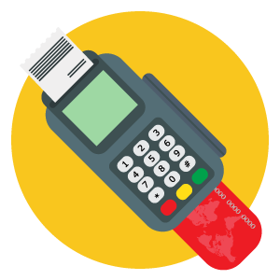
We Are Learning To:
think about ways in which money could be spent, saved and kept safe.
talk about what money is and alternatives for paying.
recognise coins and use them to add and subtract money.
Let’s continue learning

Slide 5
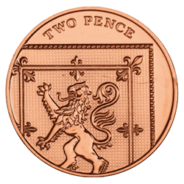
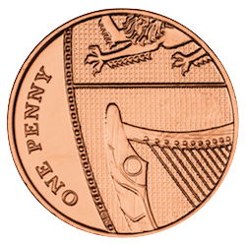
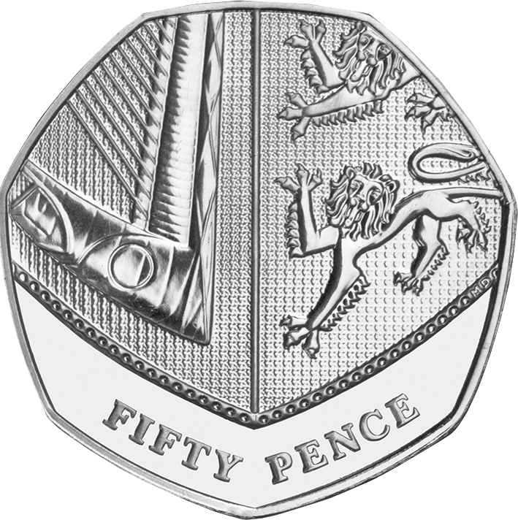
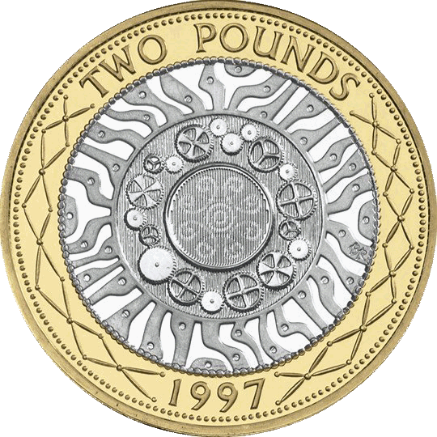
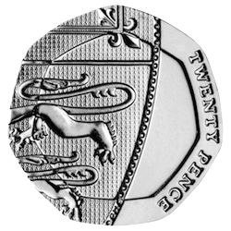
Do you recognise these coins?

Slide 6
Next question

Slide 7
Try again

Slide 8
Do you recognise these coins?

Slide 9
OR
Next question

Slide 10
Try again

Slide 11
Do you recognise these coins?

Slide 12
OR
Next question

Slide 13
Try again

Slide 14
Do you recognise these coins?

Slide 15
OR
Next question

Slide 16
Try again

Slide 17
Do you recognise these coins?

Slide 18
OR
My snack shop

Slide 19
Try again

Slide 20
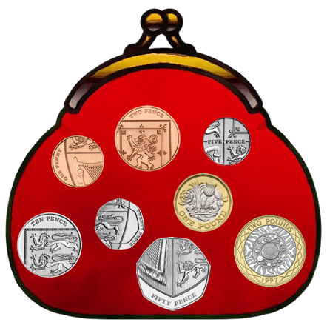
Welcome to my snack shop!
Click to enter

Slide 21
I need help adding these coins together.
?
62p

Slide 22
I need help adding these coins together.
?
£1.25

Slide 23
Can you work out what coin is missing?
35p

Slide 24
Can you work out what coins are missing?
7p
£1.08

Slide 26
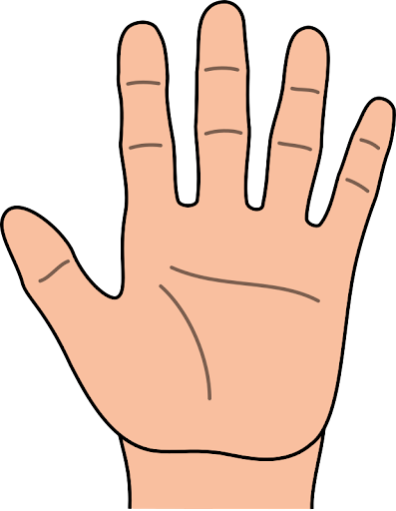
How much change does the customer need?
89p
11p
100p
89p

Slide 27
How much change does the customer need?
£2.56
4p
10p
£2.70
£2.56

Slide 28
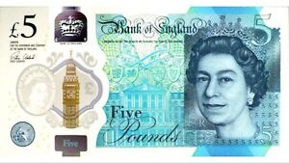
How much change does the customer need?
£3.55
£5.00
£3.55

Slide 29
Now it’s your turn to have a go. In the resource pack there are activities that you can try.
We Are Learning To:
think about ways in which money could be spent, saved and kept safe.
talk about what money is and alternatives for paying.
recognise coins and use them to add and subtract money.

Slide 30
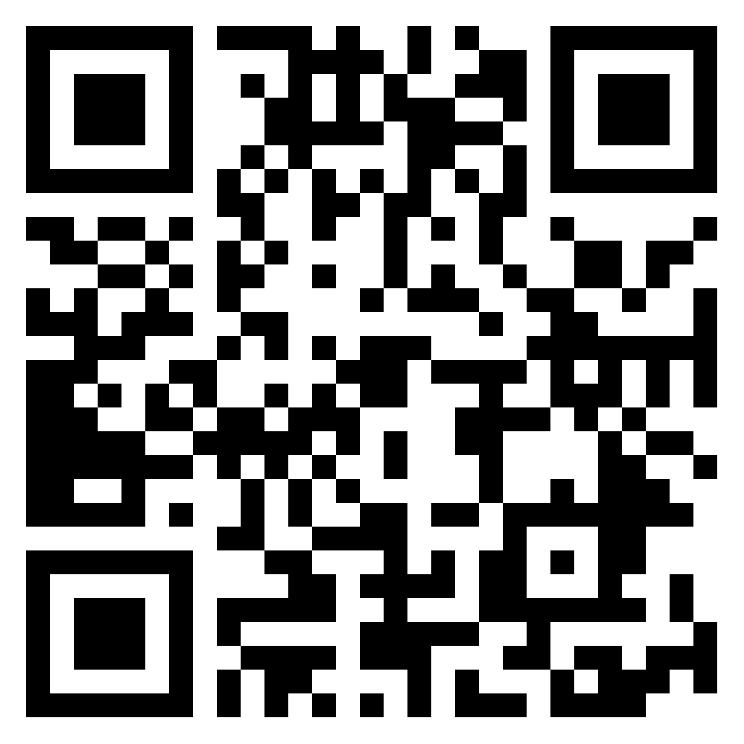
Do you want to learn more? Tell me what you have learned on our padlet page.
Practice sorting, ordering and counting coins.
Make the total using different coins or work out how much is in the coin crunchers mouth! Beat the clock.
Can you count out the exact money and give the correct change?
Practice at the toy shop.
Can you work out how much change you will get?
Use the camera, scan
to see our padlet page

