Slide 1
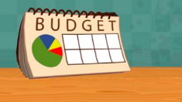
KS2 Money
All you need to know!!

Slide 2
What you need to know about money….
Be able to plan and think ahead in terms of saving and spending money, prioritise spending with a limited supply of money, understand how to access best buys.
Use the four operations to solve problems involving money.
Addition
Subtraction
Discuss the value of money, how to keep money safe, ways in which goods can be paid for and the need for budgeting.
Multiplication
Division

Slide 3
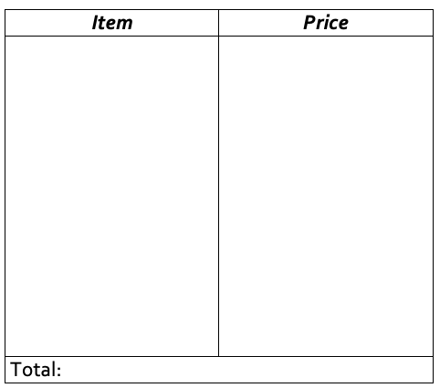
Resource 1
Can you plan weekly shop?
Try this Online Game:
Things to think about….
Super Grocery Shopper
Do you choose the cheapest items or the more expensive items?
How much money has been spent?
How much money is left over?
Additional Activity:
Compare two shopping receipts and discuss the savings that could be made.
Notes:
https://www.mathgametime.com/games/super-grocery-shopper

Slide 4
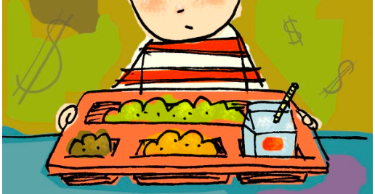
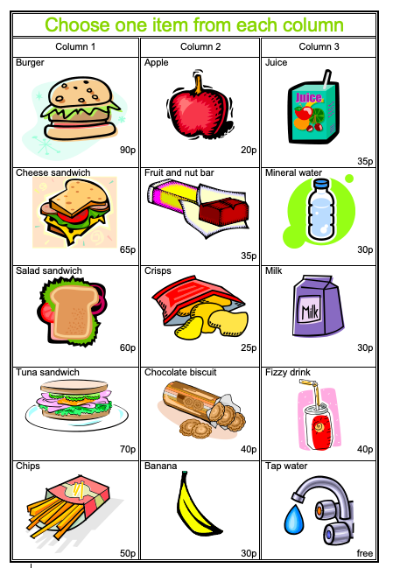
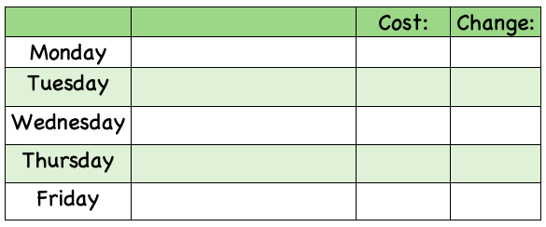
Making a healthy lunch
Resource 2
Decide on a different healthy lunch for each day of the week (You can have the same item on more than one day but not the same complete lunch).
Can you do this in your head?
Calculate the cost for each day.

Slide 5
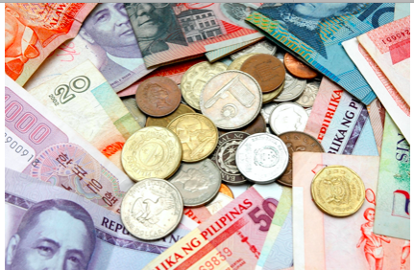
Currency
Resource 3
You could use the internet or magazines to get an idea for the prices.
Compare the cost of different items in different countries e.g. places they have been on holiday.
Can you estimate the price of an object, using an up to date exchange rate, If the rate is £1 = €1.30, multiply the cost in pounds by 1.30 to get the cost in Euros. For example, 65p: 0.65 x 1.30 = 85 cents.
Item | Dollars | Euro | Sterling
A bottle of coke | $1.25 | €2.50 | £1.00
An ice cream | $1.25 | €2.00 | 90p
A cup of coffee | $3.50 | €4.00 | £2.50
A hamburger | $4.50 | €6.00 | £3.50
Check these using an online converter!
Which currency is the easiest to convert?
How could you use a calculator to help you?
Where can you get foreign currency?
Where could you find information about exchange rates?
Can you find any coins or notes from other countries?
Notes:
https://www.xe.com/currencyconverter/

Slide 6
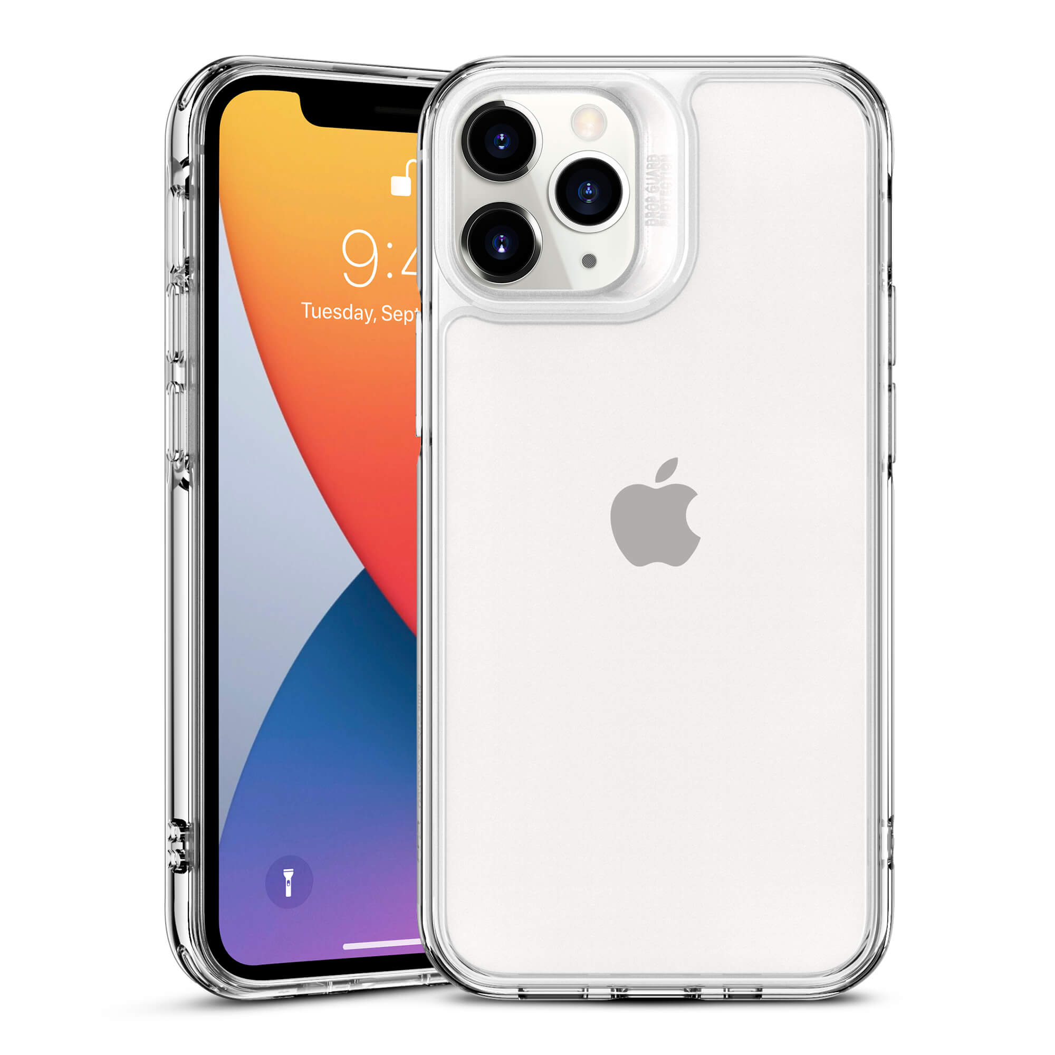
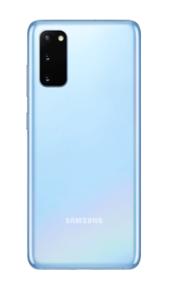
Savings-value for money
Resource 4
Remember!!
Although an item may cost more, this does not guarantee a noticeable difference in quality.
6 colours to choose from
Battery Life: 14 hours and 15 minutes
Battery Life: 10 hours and 38 minutes
Samsung Galaxy S20 FE
Screen Size: 6.5 inches
Price: £599
Price: £599
Memory: 64GB
Memory: 128GB
Screen Size: 6.1 inches
6 colours to choose from
iPhone 11
Additional Activity:
Is expensive always better?
Using the internet/magazines, choose a mobile phone for an older member of your family or a friend.
Notes:
https://www.o2.co.uk/shop/samsung/galaxy-s20-fe

Slide 7
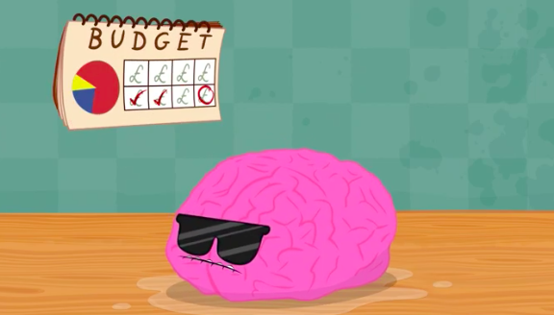
Do you want to learn more?
KS2 Maths: Handling Money & Giving Change with The Next Step https://www.bbc.co.uk/teach/supermovers/ks2-maths-handling-money-and-giving-change-with-the-next-step/zjr6kmn
Book-’The Bed and Breakfast Star’ by Jacqueline Wilson-a story about a family who has to give up their house because the money they earned wasn’t enough to pay all the bills.
Super Grocery Shopper- https://www.mathgametime.com/games/super-grocery-shopper
Financial Decision Making-https://www.bbc.co.uk/bitesize/topics/z8yv4wx/articles/zgghgdm
Have a look at these resources!!

