Slide 1
KS2 Money
A Guide for Parents
Financial Capability
Currency
Saving
Budgeting

Slide 2
What it says in the Primary Curriculum?
Pupils should be enabled to:
use the four operations to solve problems involving money;
discuss the value of money, how to keep money safe, ways in which goods can be paid for and the need for budgeting;
be able to plan and think ahead in terms of saving and spending money, prioritise spending with a limited supply of money, understand how to access best buys.

Slide 3
Discuss….
What different ways can we pay?
How would we manage without money?
Why do we need money?
Can you explain the best way to work out how to add up the cost of things?
Why should we save?
How much does it cost to have a take-away?
What are the pros/cons of pocket money?

Slide 4
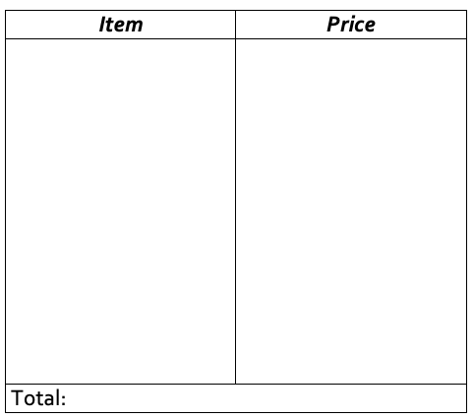
Budgeting: Planning a weekly shop
Resource 1
Online Game:
Activity Idea
Consider….
Super Grocery Shopper
Do they choose the cheapest items or the more expensive items?
How much money has been spent?
How much money is left over?
Can they add up the price as they go along.
Additional Activity:
Perhaps you could invite your child to help with a weekly shop, adding up how much it will cost.
Compare two shopping receipts and discuss the savings that could be made.
Notes:
https://www.mathgametime.com/games/super-grocery-shopper

Slide 5
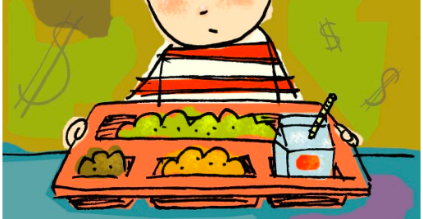
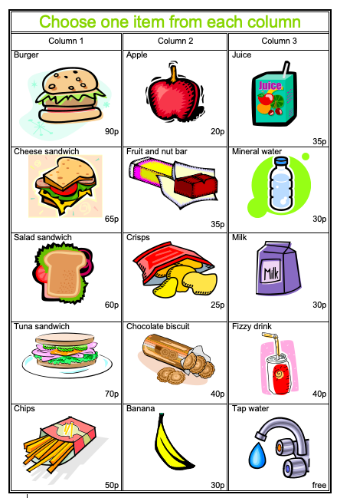
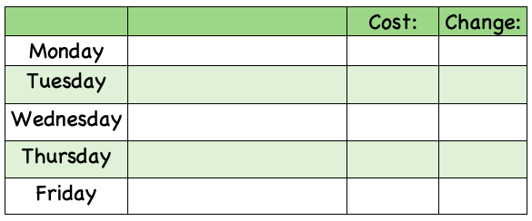
Making a healthy lunch
Resource 2
Help your child decide on a different healthy lunch for each day of the week (You can have the same item on more than one day but not the same complete lunch).
Calculate the cost for each day.
Mental Maths
Calculate how much change would be left over? Challenge them to do this in their head!!
Using number operations to solve money problems
Activity Idea

Slide 6
Currency
Resource 3
You could use the internet or magazines to get an idea for the prices.
Compare the cost of different items in different countries e.g. places they have been on holiday.
Activity Idea
Ask your child to estimate the price of an object, using an up to date exchange rate, If the rate is £1 = €1.30, multiply the cost in pounds by 1.30 to get the cost in Euros. For example, 65p: 0.65 x 1.30 = 85 cents.
These estimates can be checked, using an online converter.
Item | Dollars | Euro | Sterling
A bottle of coke | $1.25 | €2.50 | £1.00
An ice cream | $1.25 | €2.00 | 90p
A cup of coffee | $3.50 | €4.00 | £2.50
A hamburger | $4.50 | €6.00 | £3.50
If possible, show them notes and coins from a number of different currencies. Discuss what characteristics they have in common and what makes them different.
Which currency is the easiest to convert?
How could you use a calculator to help you?
Where can you get foreign currency?
Where could you find information about exchange rates?

Slide 7
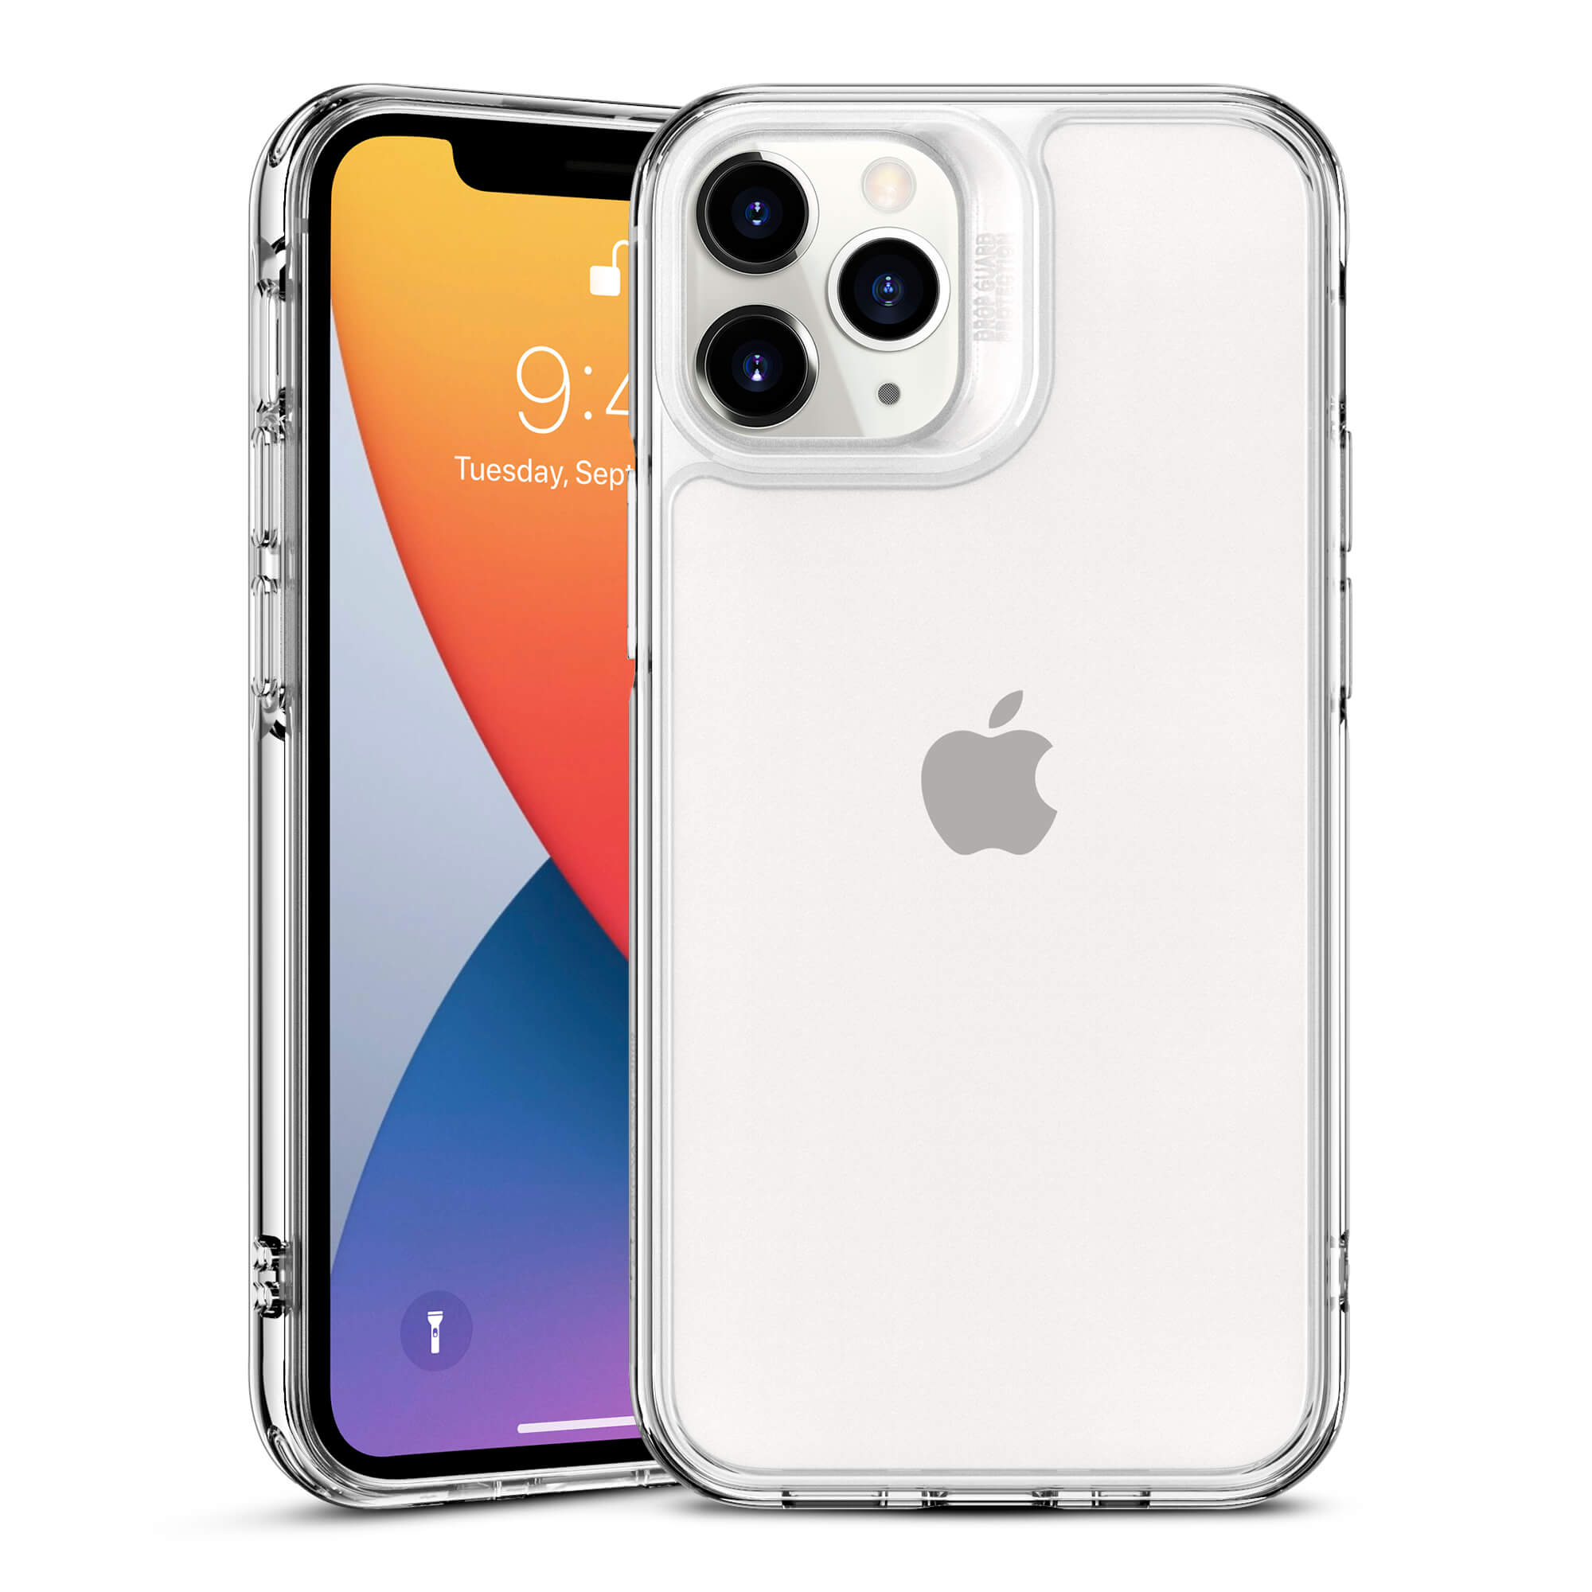
Savings-value for money
Resource 4
This will encourage your child to consider that expensive does not necessarily mean better. Although an item may cost more, this does not guarantee a noticeable difference in quality.
6 colours to choose from
Battery Life: 14 hours and 15 minutes
Battery Life: 10 hours and 38 minutes
Samsung Galaxy S20 FE
Screen Size: 6.5 inches
Price: £599
Price: £599
Memory: 64GB
Memory: 128GB
Screen Size: 6.1 inches
6 colours to choose from
iPhone 11
Activity Idea
Additional Activity:
Is expensive always better?
Using the internet/magazines, choose a mobile phone for an older member of your family or a friend.
Notes:
https://www.o2.co.uk/shop/samsung/galaxy-s20-fe

Slide 8
Key Resources-Money
Years 6 & 7 Money Wise Thematic Unit: http://www.nicurriculum.org.uk/curriculum_microsite/financial_capability/documents/money_wise.pdf?mc=fin
Talk Money, Talk Solutions: http://www.nicurriculum.org.uk/curriculum_microsite/financial_capability/documents/tmts/TalkMoneyTalkSolutions.pdf
Financial Capability: Money Event: http://www.nicurriculum.org.uk/curriculum_microsite/financial_capability/documents/ME%20-%20money%20event.pdf?mc=fin
Living, Learning Together: Money Matters (Year 4): http://www.nicurriculum.org.uk/docs/key_stages_1_and_2/areas_of_learning/pdmu/livinglearningtogether/year4/yr4_unit5.pdf

