Slide 1
Play based learning
Foundation Stage and KS1 – Advice for SBW

Slide 2
Planning for play

Slide 3
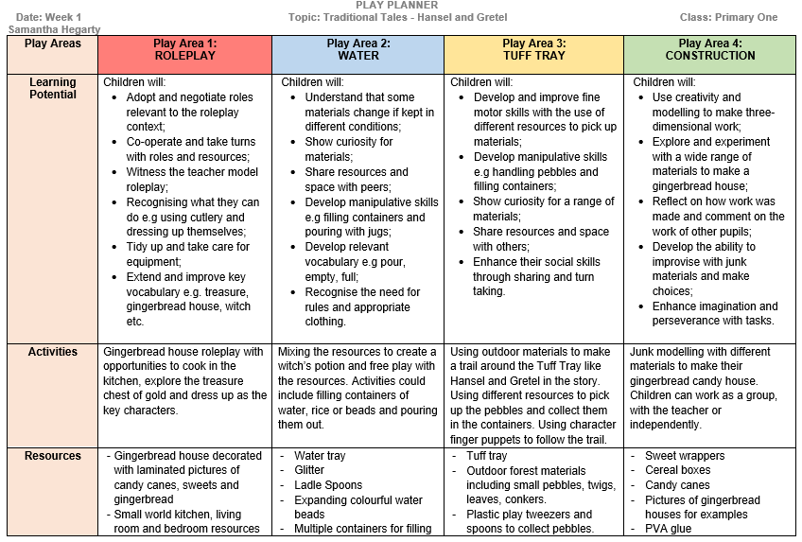

Slide 4
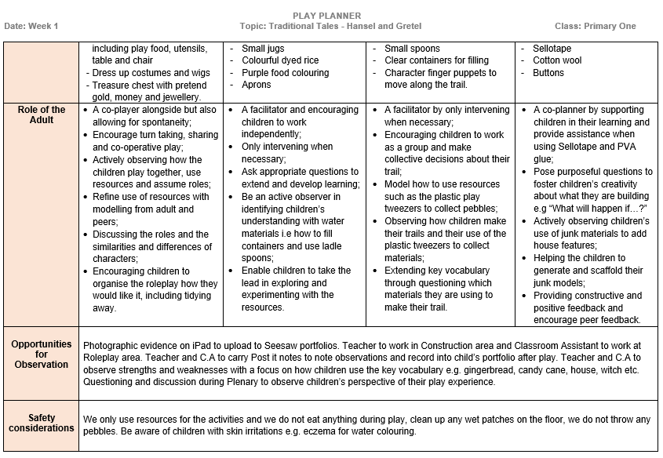

Slide 5
Exciting play!

Slide 6
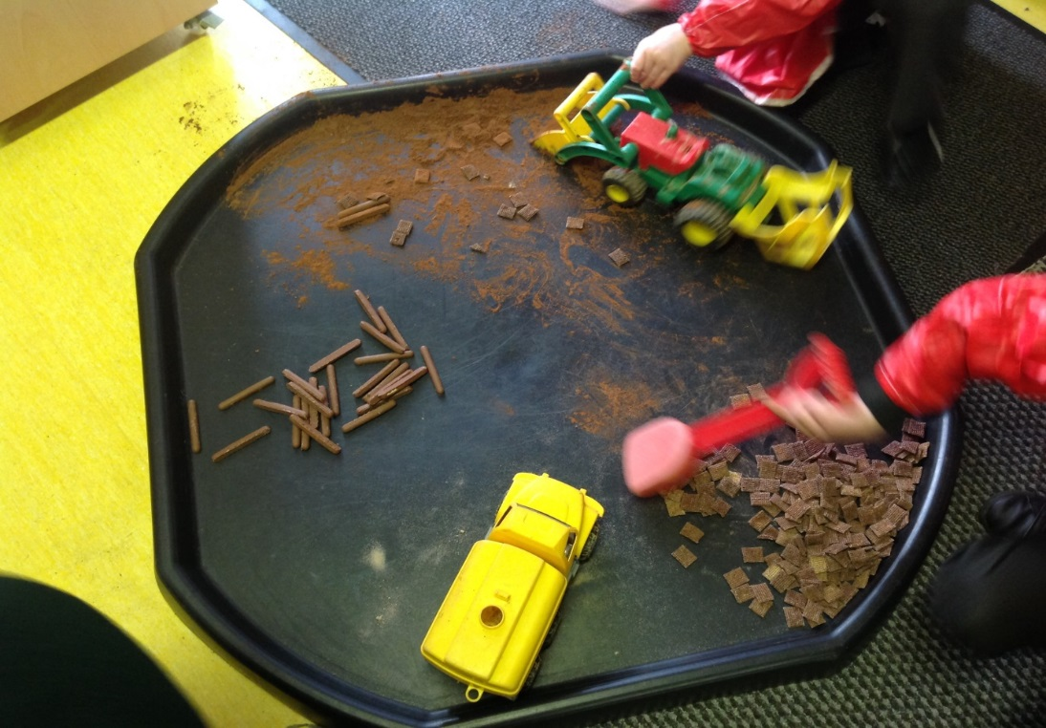
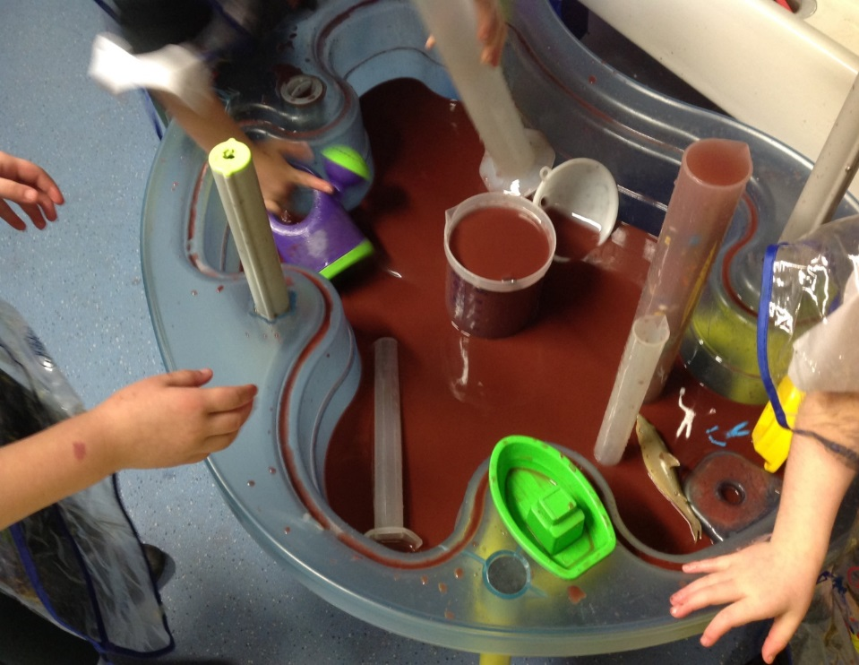
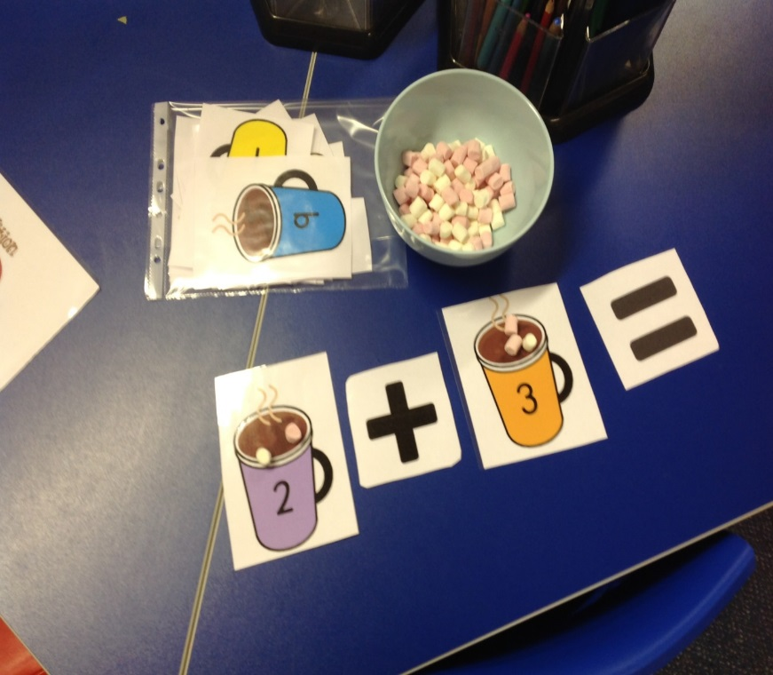
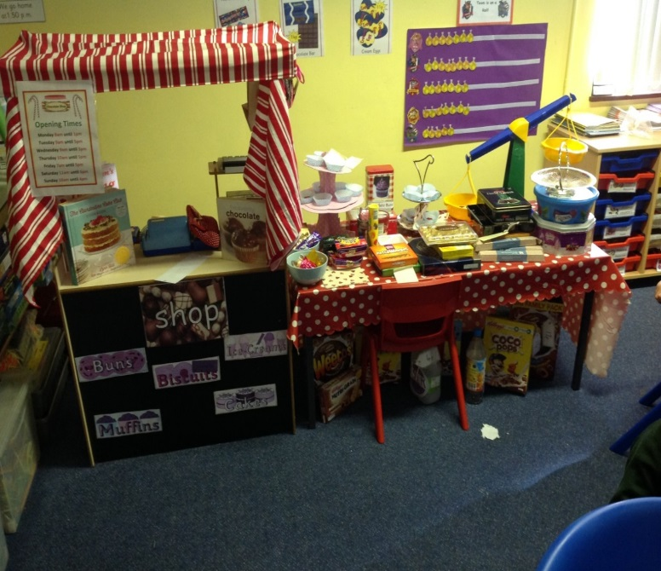
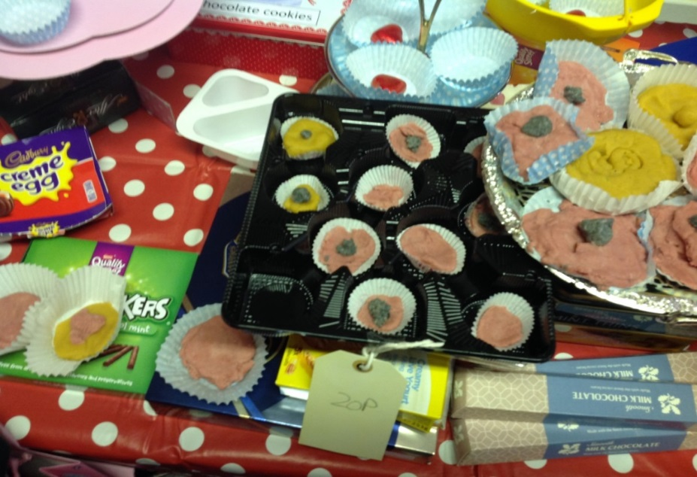

Slide 7
Organising children and play

Slide 8
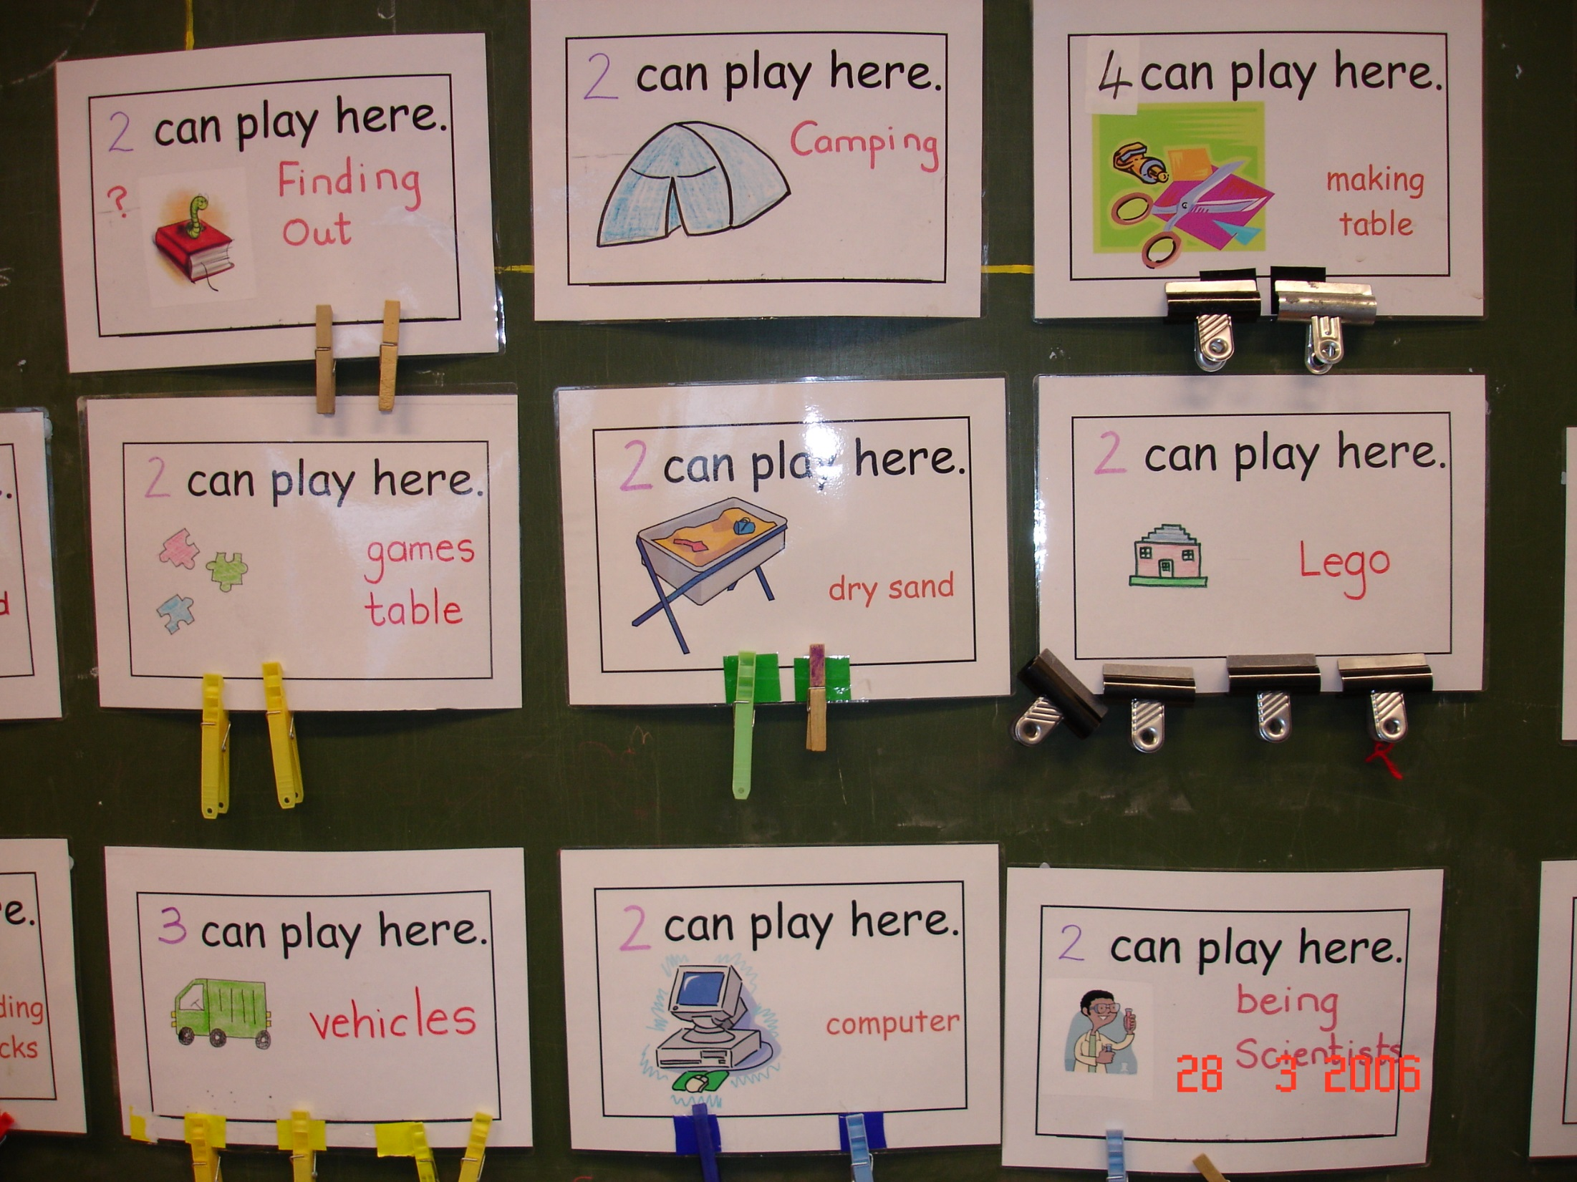

Slide 9
Assessing play

Slide 10


Slide 11
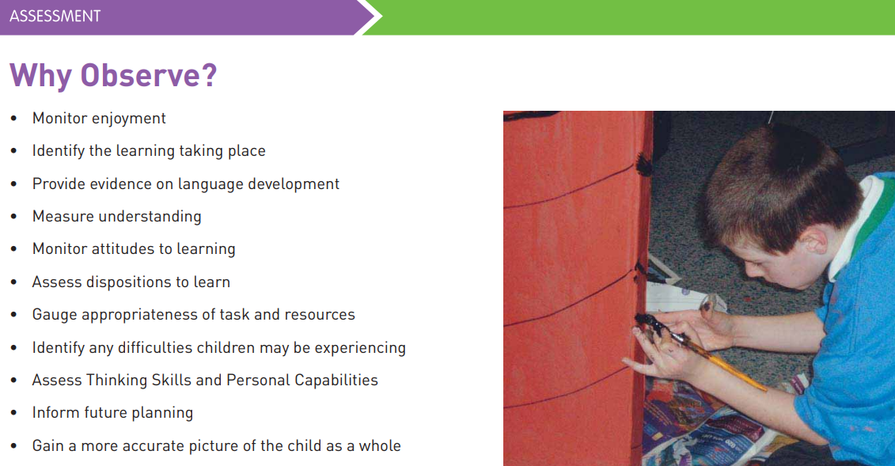

Slide 12
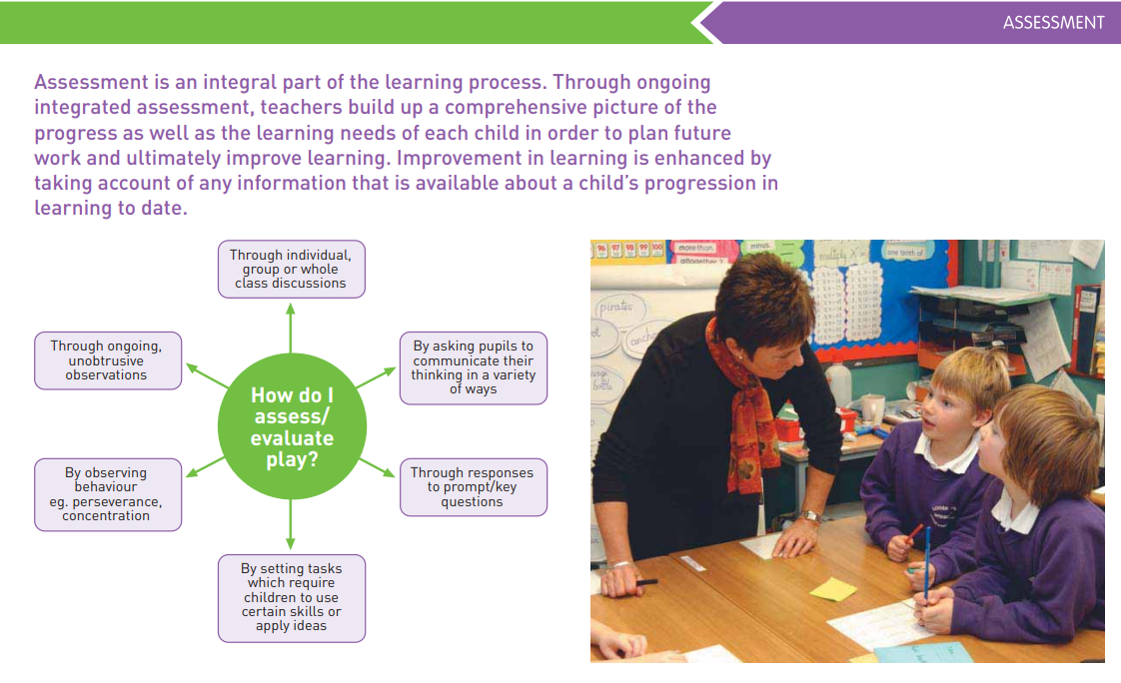

Slide 13
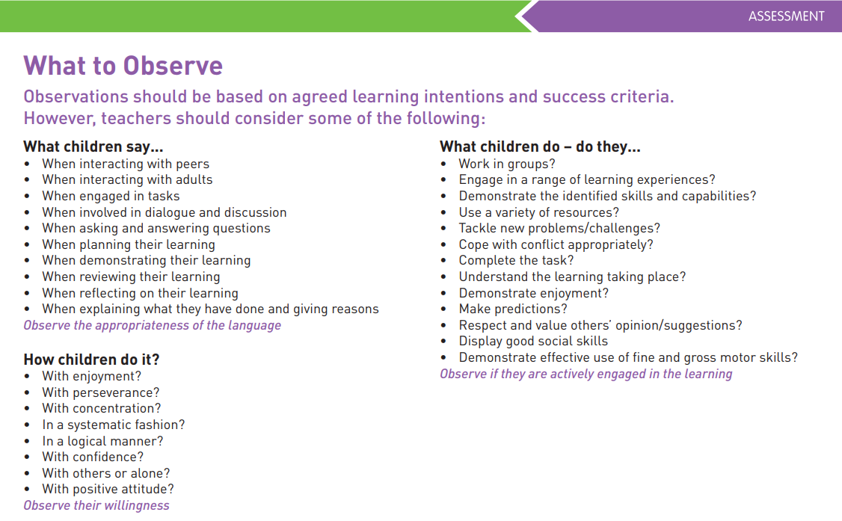

Slide 14
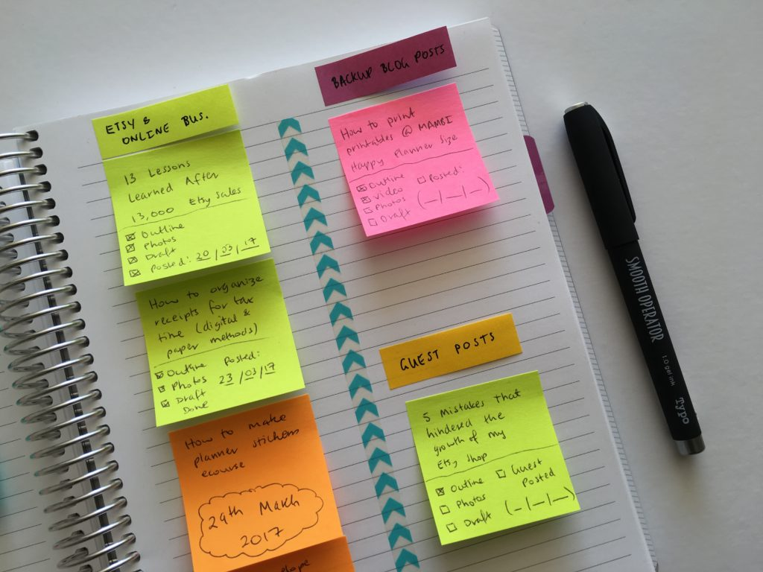


Check list: Written observations:
The simplest form of observation where the observer checks off listed behaviours.
Written notes in a notebook or on Post-It notes which you might add to a file page in your assessment folder.

Slide 15
Enjoy SBW!

