Slide 1
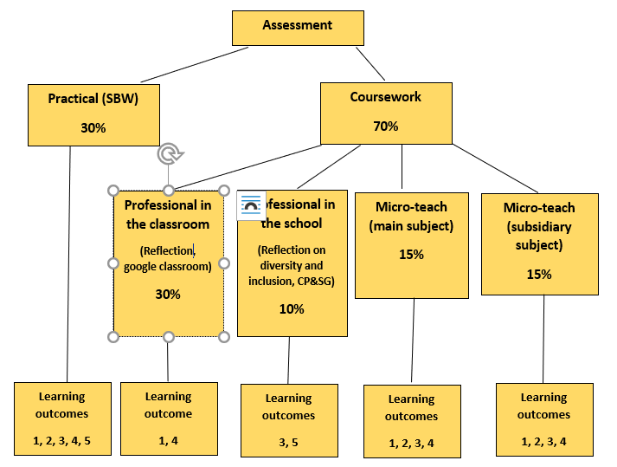
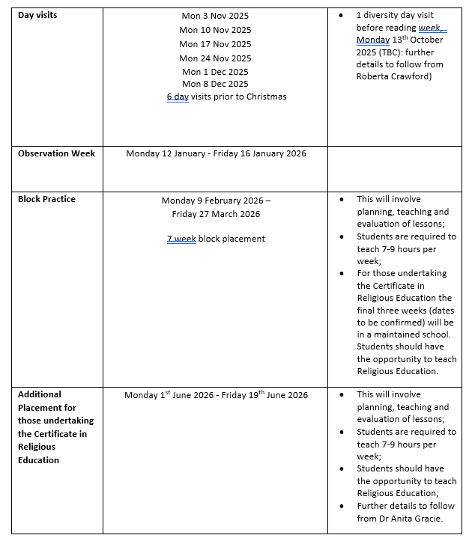

Assessment of year 1 PPL

Slide 2
Preparation for placement
Learning Outcomes
By the end of the course students should be able to:
Plan lessons in their applicable subjects and other areas such as LLW;
Deliver lessons competently in their applicable subjects and other areas such as LLW;
Reflect on their teaching using the GTCNI competences;
Develop personal skills in UICT, literacy, numeracy and study skills;
Develop awareness of child protection and safeguarding procedures for school-based work (SBW).
Transferable skills Students will be able to:
Employ a VLE effectively for planning and dissemination of resources;
Communicate effectively with peers, pupils and other professionals orally and in writing;
Demonstrate satisfactory competence in numeracy skills and incorporate such skills as part of their lesson planning;
Present subject knowledge in an effective and well-managed manner;
Use their voice effectively in a classroom environment;
Employ a range of effective personal study skills;
Begin to manage behaviour within a classroom environment.

Slide 3
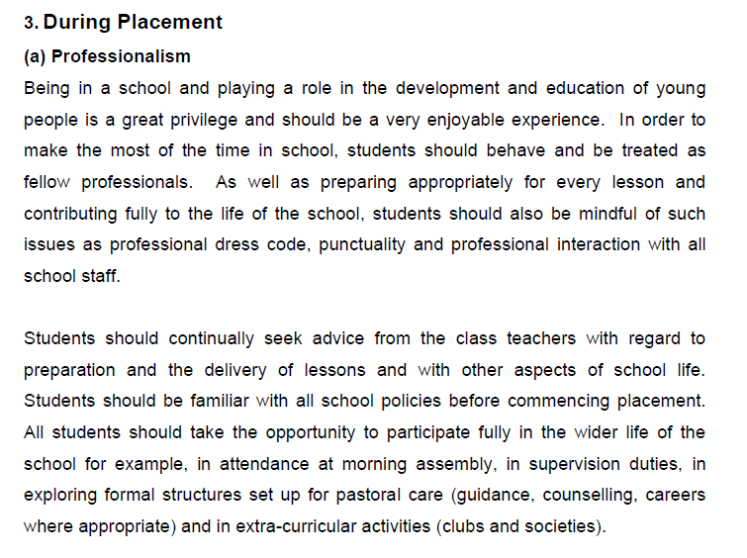
Key document on Canvas
Guide to SBW 2025-2026
Professionalism (Pg 5)
Preparing for lessons
Contributing fully to the life of the school
Professional dress code, punctuality, professional interaction
Seeking advice from staff members
Awareness of school policies
Use of confidential information
Social media
Guidance regarding field trips, attendance/absences, schools closures, issues and concerns

Slide 4

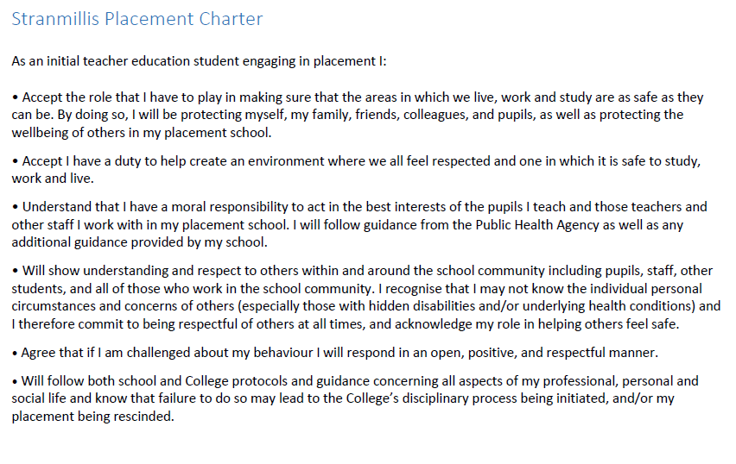
Stranmillis Placement Contract
Sign and place at front of SBW file
Other points:
Dress code – professional
It is especially important to be discreet, take great care with confidential information
Remember you are showcasing yourself for the future
Think about taking advantage of all opportunities to be an employable asset to the school
‘Small’ things count – especially your attitude
Show initiative and engage with pupils/teachers/school life

Slide 5
Social networking sites
They have their benefits but have been the cause of a lot of problems !!!
Remember….. A professional image
If the school has a policy on social networking sites, please ensure you comply with it.
Please do not do any of the following (even if they contact you)
Contact parents of the school
Contact children of the school
Use these sites to express your opinions of the school/its staff/or any aspect of its function
If in any doubt, please talk to me, Dr Bell, or your SBW tutor

Slide 6
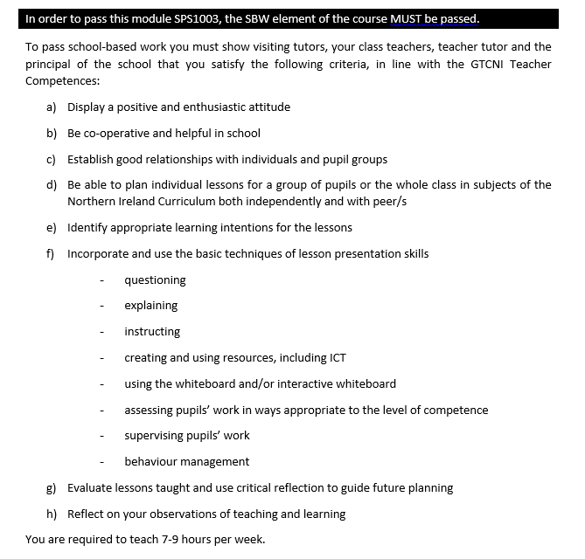
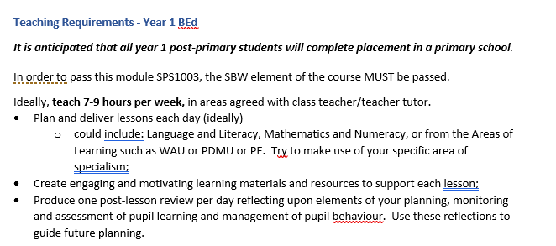
What am I required to do? Passing the module

Slide 7
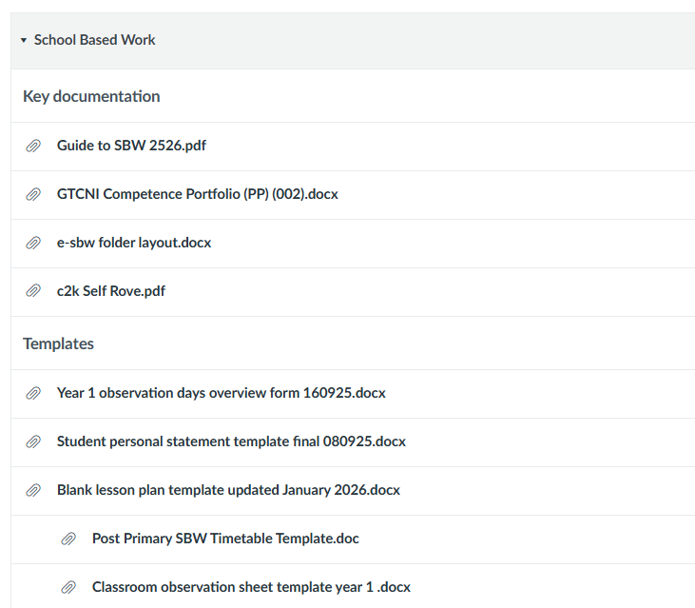
What to do now?
Get organised
Access resources on Canvas
KEY DOCUMENTS TO ACCESS
Guide to School Based Work
PPL course guide
Assessment guidance
Access relevant forms eg lesson plan template, tutor report form
Finalise timetable and upload to placement software (and share with SBW tutor, once informed of contact)
Finalise topics with teachers
Access teaching resources to help prepare lessons
Make contact with SBW tutor next week (once names have been released)
Ensure you are clear about requirements for placement
Ensure clarity about Child protection procedures
Set up e-SBW file with relevant folders (upload personal statement, SBW charter, observation forms and policies)

Slide 8
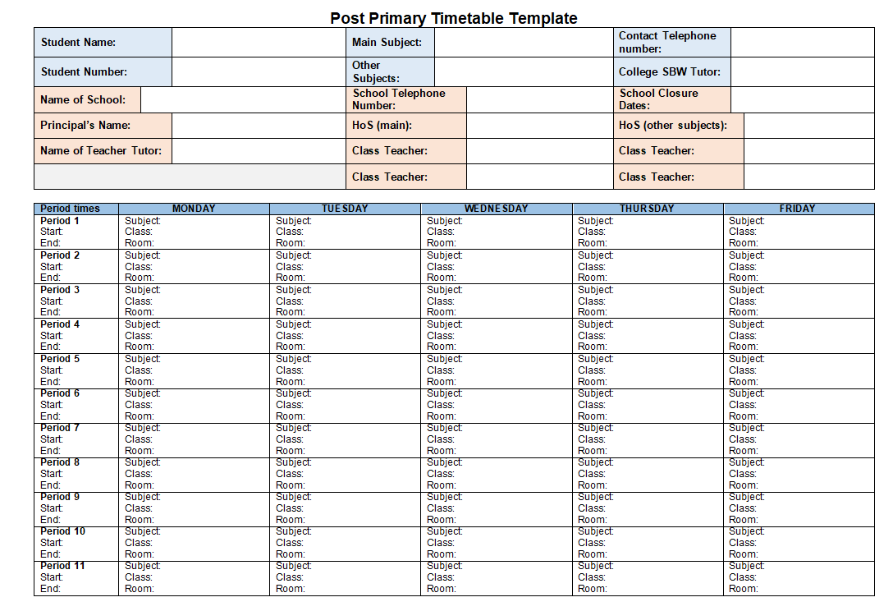
Please speak to your teacher and try to agree a timetable for the block placement.
Enter the details on the template below (available on Canvas).
You must use the template provided
Once you have agreed your timetable with your teacher, please upload to the Placement Software system.
It would also be useful to email a copy to your SBW tutor.
All students to share their timetable, and any changes that are made at a later date, as soon as possible
https://stran.sharepoint.com/sites/StranmillisStudentIntranet/SitePages/BEd-Post-Primary.aspx?web=1
Timetable template (on SBW folder on Canvas and student intranet)

Slide 9
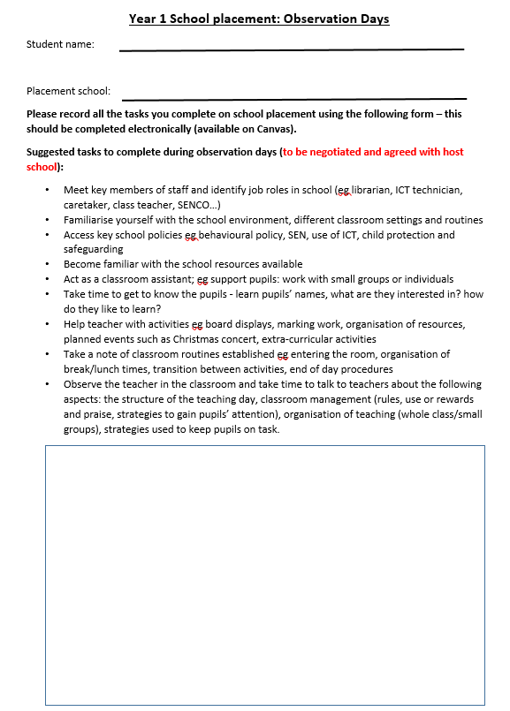
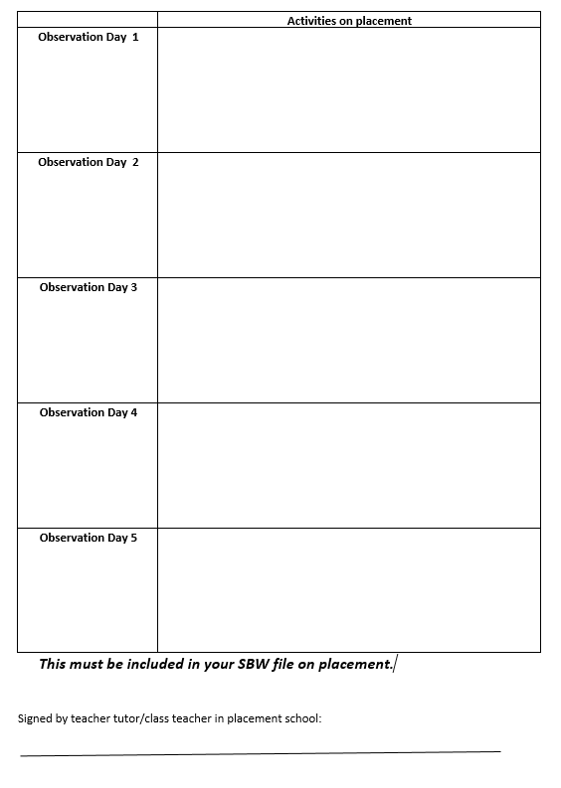
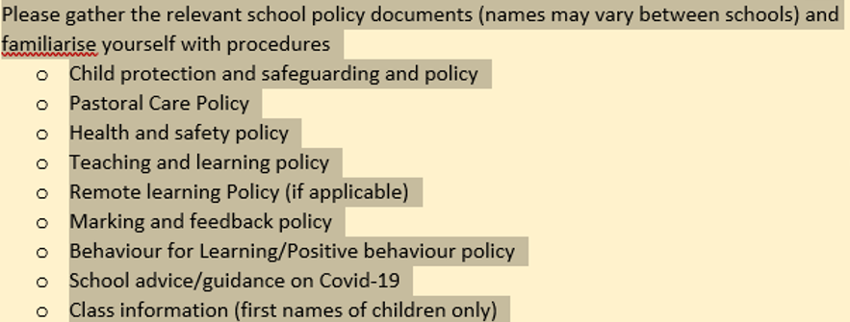
Please ensure this is fully completed and save electronically.

Slide 10
Attendance
You are required to update your attendance daily on the Placement software
Follow SBW protocols carefully – contact school, placements@stran.ac.uk SBW tutor
See Guide to SBW, pg 6

Slide 11
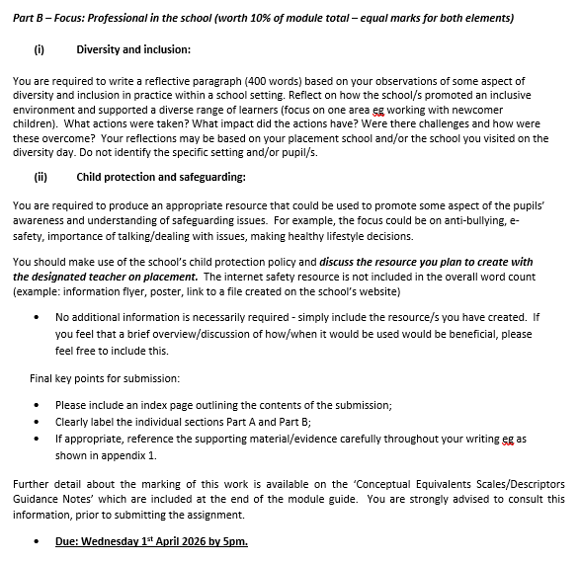
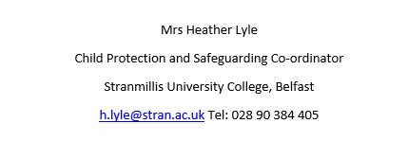
REMINDER Child protection: School-based work checklist
Read the College Child Protection and Safeguarding Policy (internal website)
Revisit your child protection class notes and presentation
Read your school Child Protection and Safeguarding Policy
Find out who the school’s Designated Teacher is
Ensure you keep a copy of this information and contacts at all times
See Guide to SBW

Slide 12
New this year mid-placement review day, year 1
Pg 8
(g) Mid-Placement Review Day
Year 1 BEd Primary and Post-Primary students will attend a Mid-Placement Review Day in College (end of Week 4). Staff from Primary, Post-Primary and Student Support Services will help to facilitate a day where students can reflect on how their first placement has gone so far and consider how practice might be further enhanced within the remaining weeks of the block. Students will be afforded the opportunity to converse with one another and to share experiences. This Review Day is in place of a day in school. Therefore, attendance is compulsory and will be recorded. Any student who fails to attend this event will be required to complete an additional task.

Slide 13
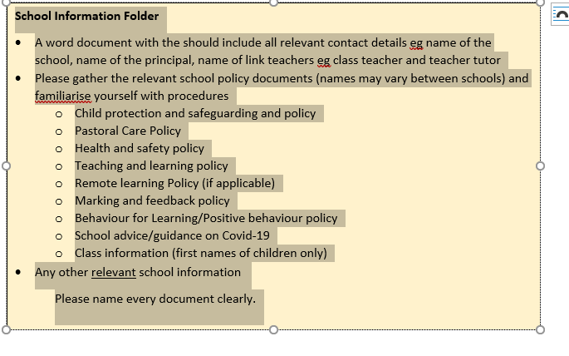
Your e-SBW File
You must maintain an e-SBW file in which you will record and analyse the information gathered and the activities carried out during your School Based Work.
This is a file of evidence of your plans – past, present and future
Organisation and presentation are key
The artefacts contained in your file will take a range of forms, and should include the following: personal observations, lesson plans, lesson resources, pupil work (anonymous/if permitted) and official material from your school.
Make this available to your SBW tutor on all visits and the class teacher at all times
Ensure this is up to date at all times

Slide 14
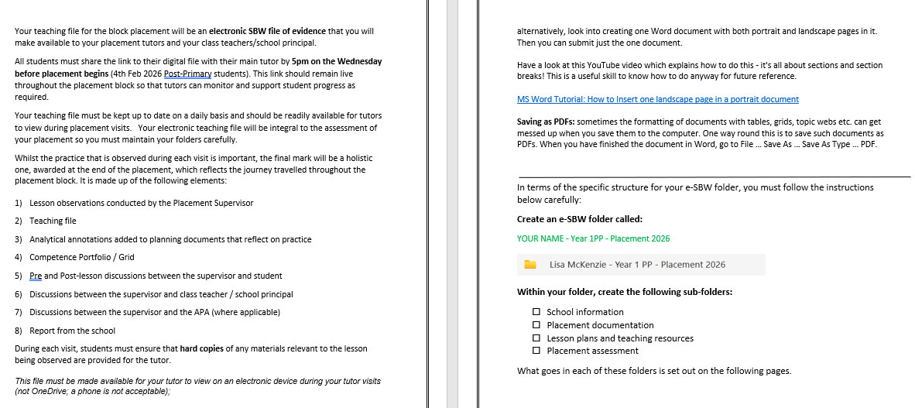
See relevant documentation

Slide 15
For each class you are teaching you should include:
Individually dated lesson plans for each session: these must include link to curriculum, learning intentions, success criteria, introduction, development and conclusion, resources, key questions, strategies and assessment/homework
Link to subject specification, statements of minimum entitlement, curriculum guidance material …. as appropriate
Lessons should provide evidence of having incorporated cross curricular skills and thinking skills and personal capabilities
1 copy only of all resources/activity sheets/assessment activities you are using during class
Annotate the lessons plan to review the lesson (use updated lesson plan template) One per day. Please ensure you date and label these appropriately.
See updated lesson plan on Canvas
See exemplar

Slide 16
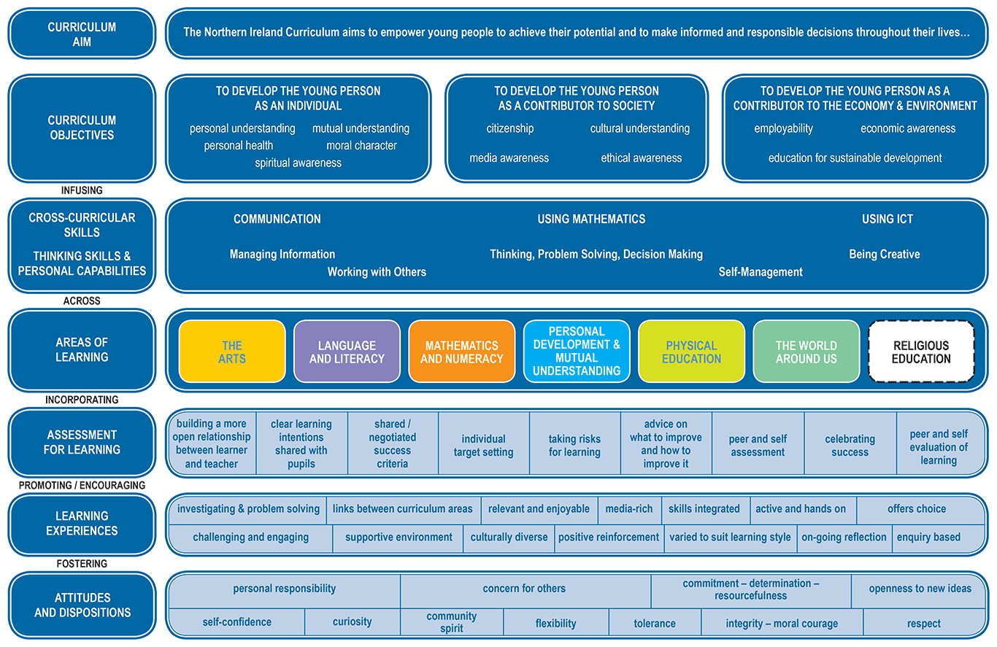
The Primary Curriculum

Slide 17
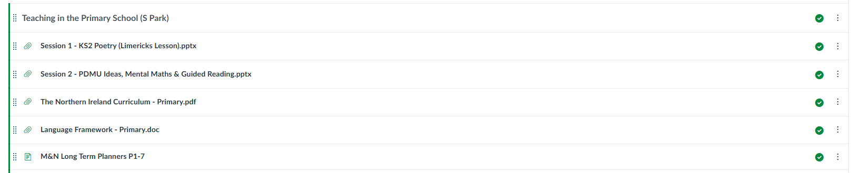
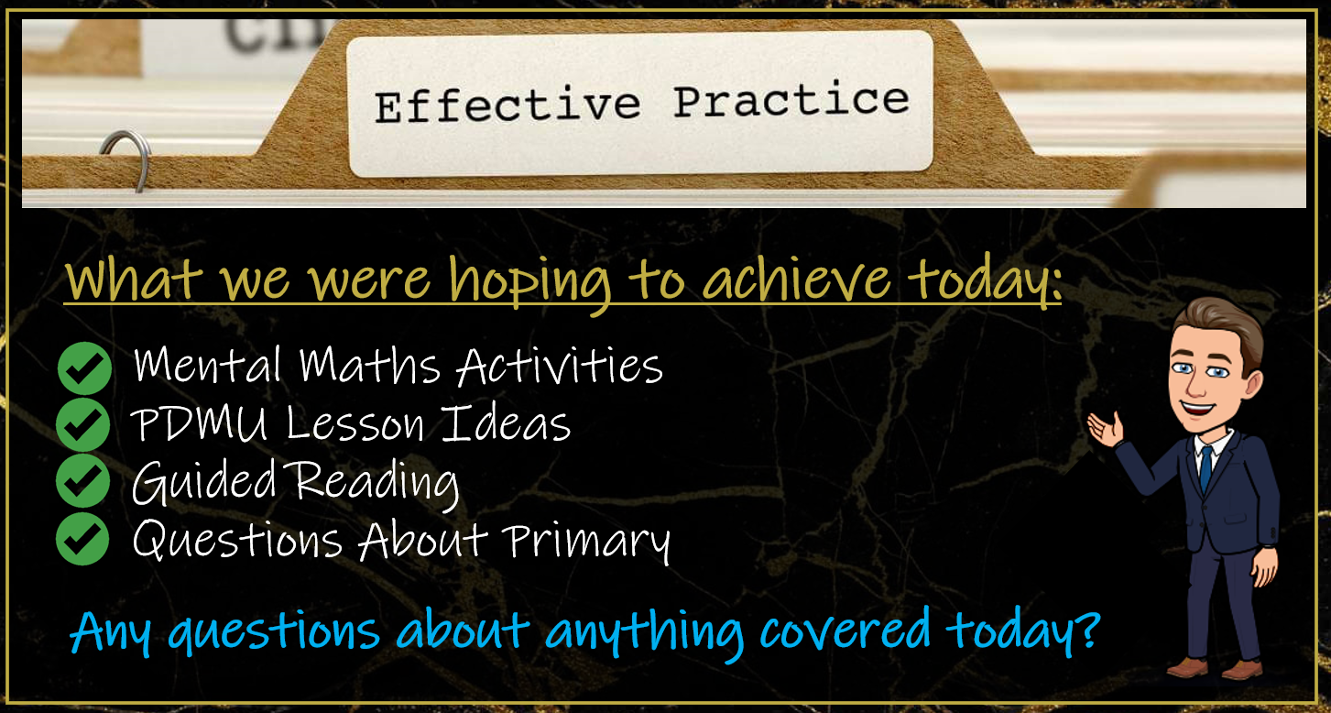
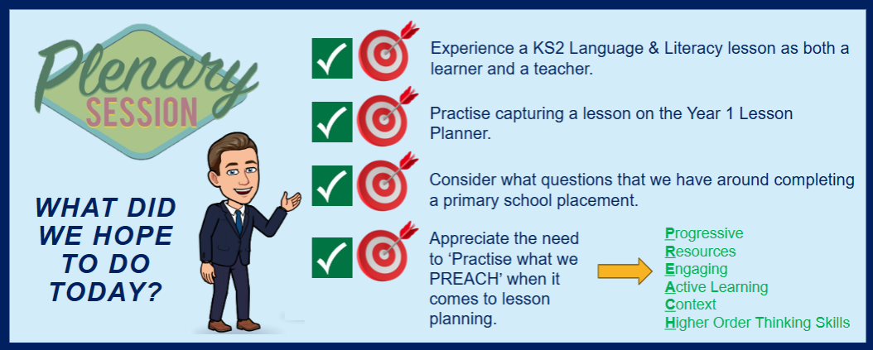


Slide 18
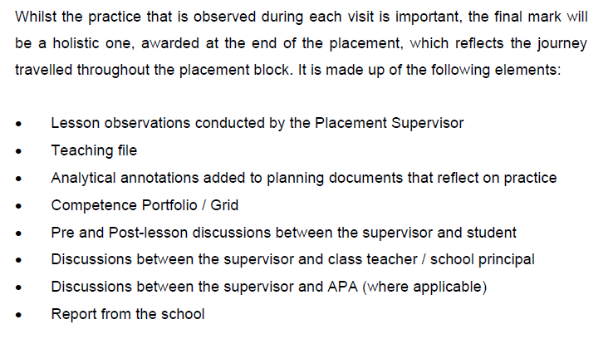
Supervision and assessment
See page 10
On the day of the visit:
You must have a hard copy of the lesson plan and resources available to hand to the tutor.
You must make your e-SBW file available on an electronic device
Ensure your file is up-to-date.
Questions you may have:
How will I make arrangements with my tutor to visit?
What will happen when my tutor visits?
Any others?

Slide 19
At the end of placement, the following forms need completed and submitted to placements:
BEd Post Primary School Record Form
This now being done through the placement software - you will be required to complete the front of the form and leave it with the class teacher who will complete the back of the form. The form will be returned by the Principal/teacher tutor.
You will have received separate guidance on how to access the Placement Software.
Travel Claim Form (where applicable)
See page 9, Guide to SBW.
Please make sure you…..
Return any borrowed materials to your placement school
Ensure all meals/refreshments have been paid for
Complete the necessary forms
Be sure to thank the school for having you and thank for guidance/support. Remember you are guests in their school!

Slide 20


