Slide 1
Assessment EXPECTATIONS AND practices
SBW 2025-26

Slide 2
Consolidation of educational and curricular knowledge
Understanding of the requirements of the NI Curriculum
Understanding of cognition and learning:
  Recognition of Gifted and talent pupils
  Recognition of Looked After Pupils
  Recognition of Newcomer/EAL pupils
  Recognition of pupils with medical
  Recognition of pupils with Special Educational Needs

Slide 3
Year 4 SBW
Student files should reflect:
Consolidation of educational and curricular knowledge
Evaluation of their teaching and learning of pupils; collectively and individually
Self- reflection; personal and professional development
Student files should be a working document rather than a collection of academic prose

Slide 4
Reflective Dialogue
You are encouraged to involve the class teacher, in your monitoring and evaluation;
You may find it helpful to discuss your developing understanding of assessment with other students;
Engage in conversations with other teachers/co-ordinators

Slide 5
Evidence of competence
In action: Observation, targeted questioning and discussion.
Documentation: Record-keeping and marking activity
Focus on
assessment in Year 4
In action: immediate feedback, dialogue and questioning with learner; self-assessment practices. Documentation: Using LI and SC to inform comments on marked work, noting strengths and targets
‘knowledge of ipsative, formative and summative assessments’ e.g. IEPs, grouping strategies
Documentation: pre-placement data gathering (assessment portfolio), planners and weekly evaluations, marked work, testing
‘Uses ipsative, formative and summative assessments’ e.g. lesson planning (schemes and planners), evaluations, re-grouping

Slide 6
Mainstream schools ONLY:
Portfolio of Assessment Evidence
Examples of evidence:
Your evaluations, your lesson plans, your annotated schemes (online);
Examples of pupils’ marked work focusing on feed-back and feed-forward e.g. 2 stars and a wish. Think about comments!
Record of formal training with CCEA on levelling in numeracy and communication;
Examples of monitoring - records of marks e.g. weekly spelling test scores; homeworks;
Running records of reading groups;
Play/activity-based learning observations (photos and post-it notes);
Use of pre-existing data and information: ask about levels; PLPs; discussions with class teacher (written-up)
Evidence of peer assessment (group work), self-assessment (lesson plans; photographs)

Slide 7

Creating your file
Mainstream
Whole class evidence:
Groupings
Differentiation
Examples of pupil work has been annotated
Examples of how pupil progress is monitored
Case studies: 1 and 2 ( separate sections in your file)
How work has been linked to PLPs/ targets
Written/ produced/ photographic evidence
monitoring
Post-SBW summary of progress – how effective was your planning?
For Mainstream students a hard copy assessment evidence folder should contain two case studies with evidence of monitoring and evaluation of whole class pupil progress pupil progress and two case study pupils.
For Special School students, only a hard copy Case studies folder is required.
Special School
Up to 7 case studies:
How work has been linked to PLPs/ targets
Written/ produced/ photographic evidence
Dated monitoring
Post-SBW summary of progress – how effective was your planning?
Notes:
Students should maintain a portfolio of evidence of the formative and summative assessment practices they are developing. Students might wish to highlight their developing awareness of good practice through:
thoughtful and sustained use of learning intentions and success criteria;
evidence of giving meaningful feedback to pupils;
evidence of setting and marking homework;
monitoring reading groups: creating running records;
evidence of discussion with teaching assistants to support learning;
use of summative tests/scores to inform plans;
annotations/amendments to schemes of work in response to learning observed.

Slide 8
All students:
Portfolio of Assessment Evidence – case studies
Case studies containing:
Individual pupil profiles
Individualised targets based upon PLPs and linked to relevant assessment criteria e.g. Key stage markers/ Q Skills/Pre-requisite skills
Evidence of the tracking of pupil progress against set targets
Evidence from children’s work. This may include photographic evidence.
Annotations/amendments to Medium term/ 7-weekly planner/ weekly/daily planner in response to learning observed.

Slide 9
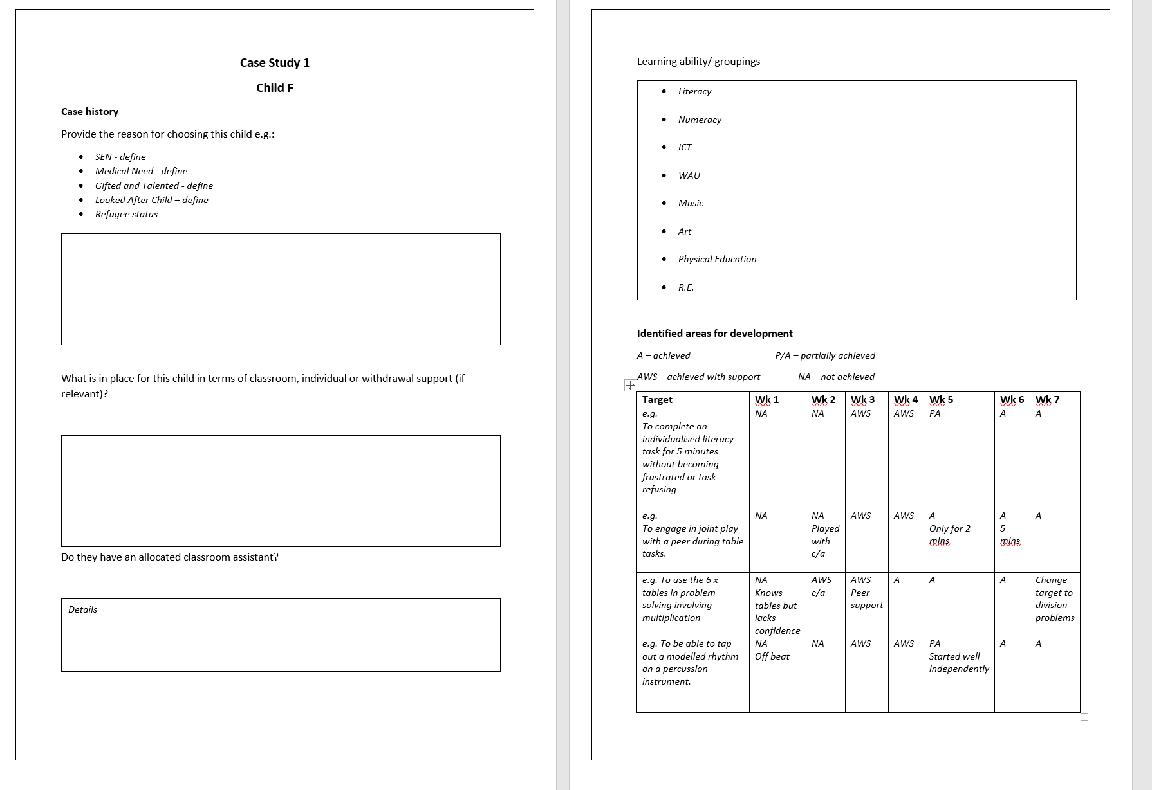
Creating your file
Individual case study files

Slide 10
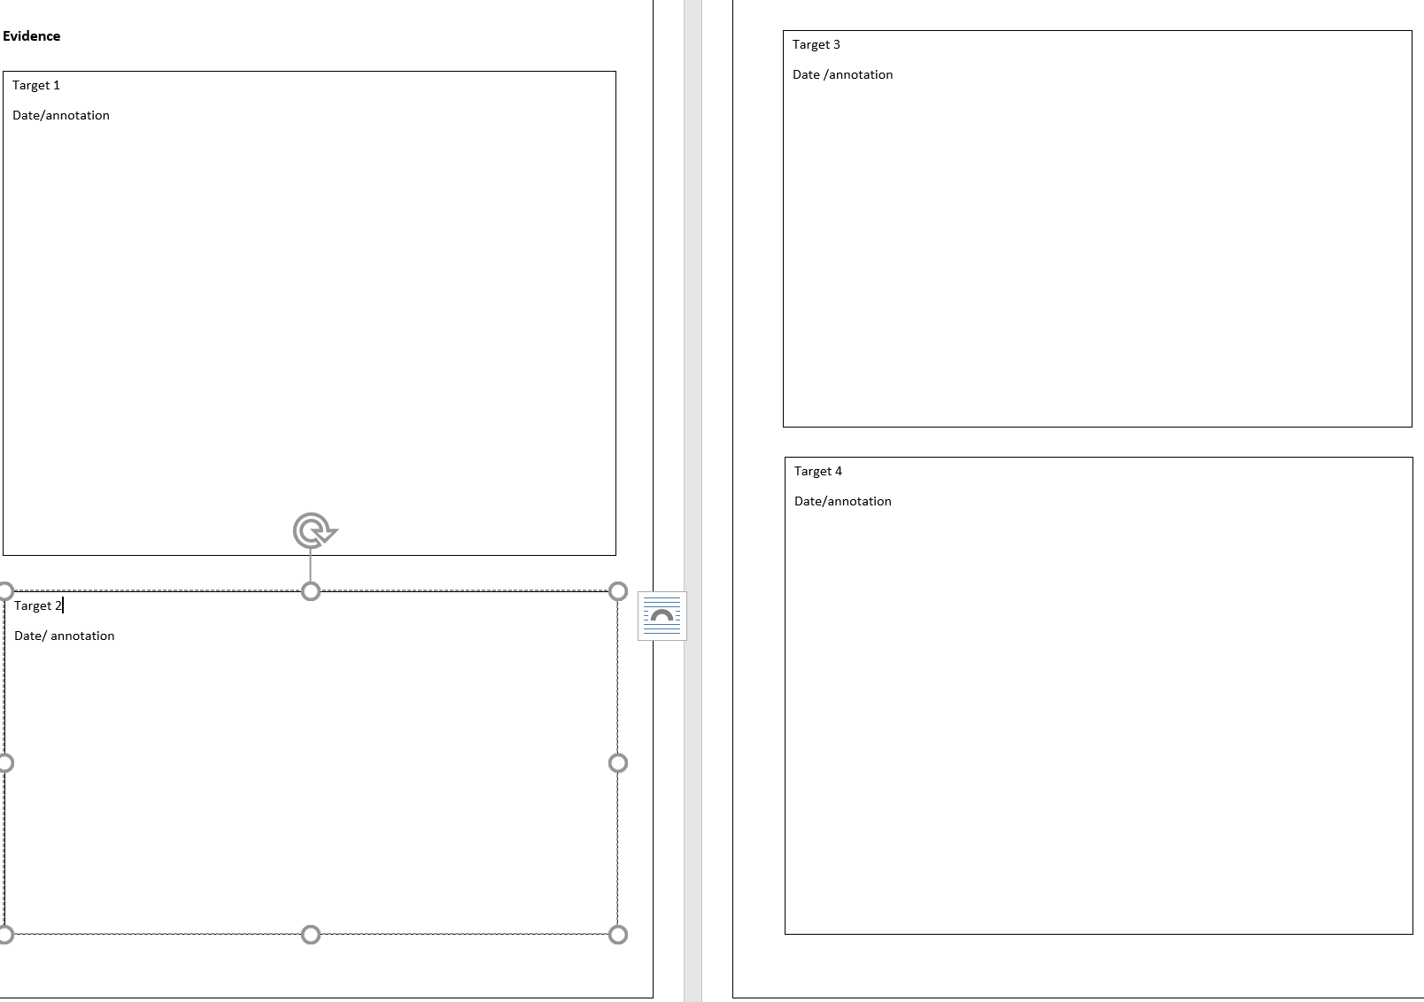
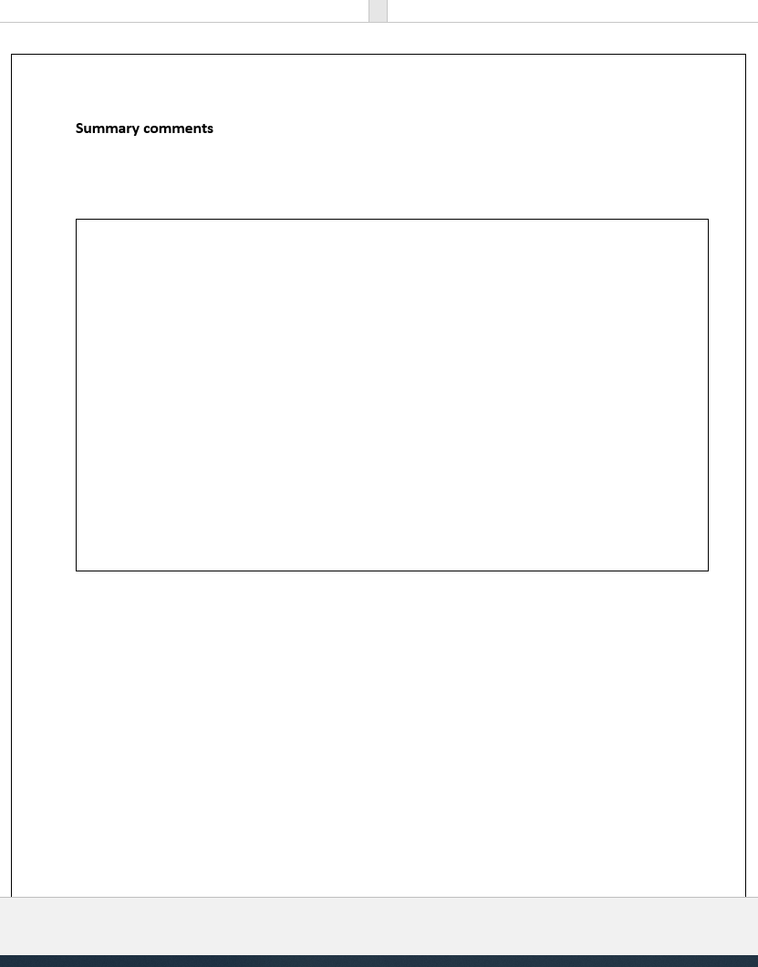
Creating your file
Individual case study files

Slide 11
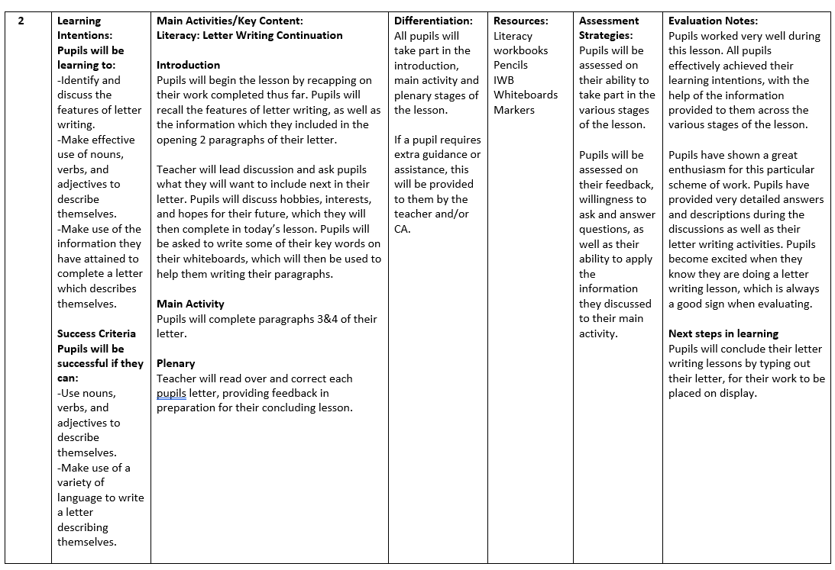
Evaluation of their teaching and learning of pupil: collectively and individually
Evaluations in daily notes

Slide 12
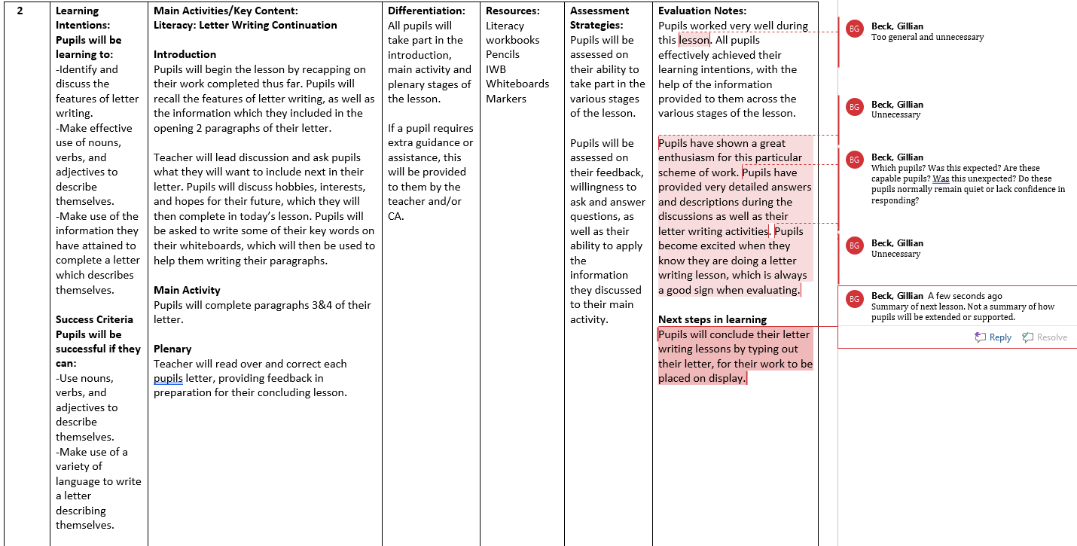
Evaluation of their teaching and learning of pupils: collectively and individually
Evaluations in daily notes

Slide 13
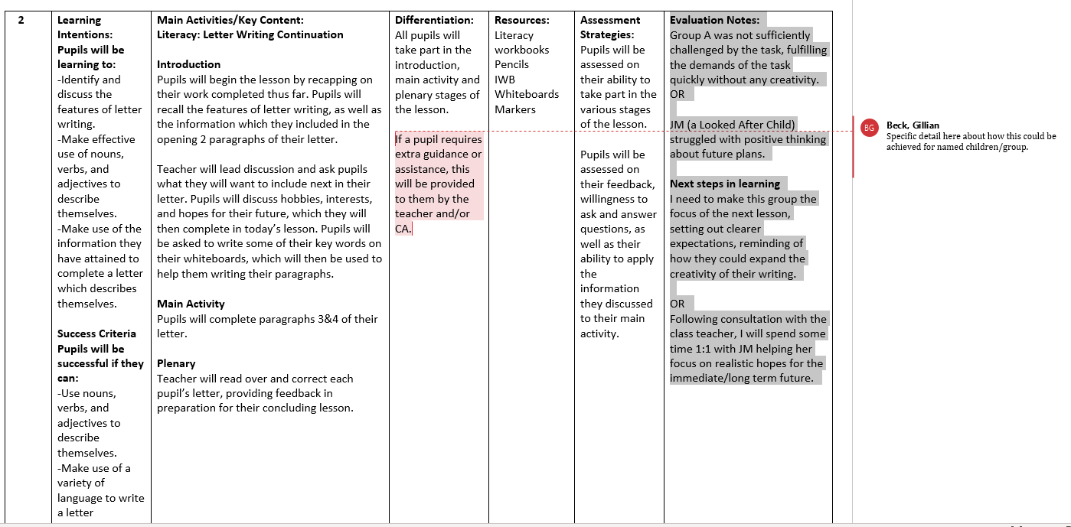
Evaluation of their teaching and learning of pupils: collectively and individually
Evaluations in daily notes

Slide 14
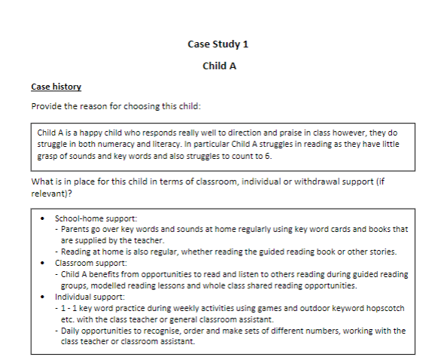
Evaluation of their teaching and learning of pupils: collectively and individually
Case studies:
Mainstream – two case studies – selected for purpose e.g. LAC, SEN, G&T
Special School all pupils recorded as cases studies in assessment folder

Slide 15
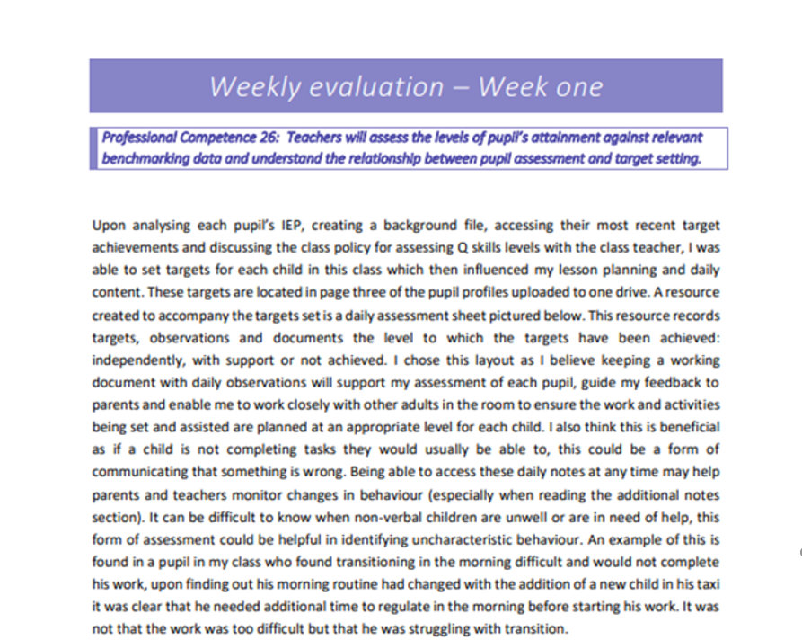
Self- reflection: personal and professional development
3. Weekly evaluations based on GTCNI competences

Slide 16
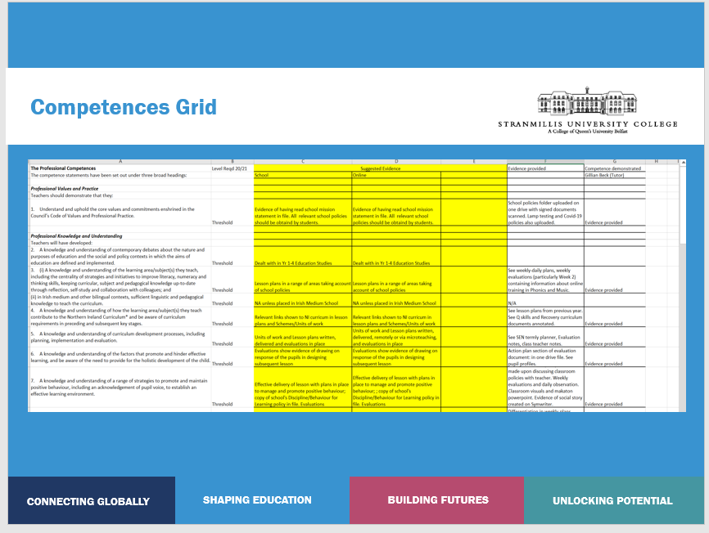
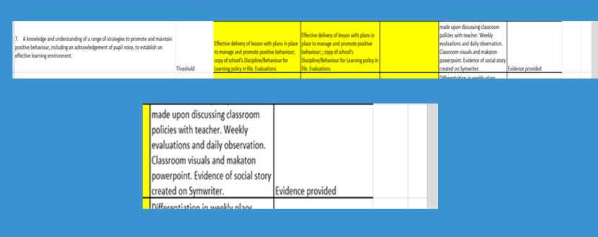
Self- reflection; personal and professional development
Competence grid

